Slide 1
PSYC 3510 – Lecture 5

Slide 2
A high-pitched tone is consistently followed by foot shocks when rats are placed in a box. What is the CS?
Tone
Shock
Freezing in response to the tone.
Freezing in response to the shock.

Slide 3
A light is consistently followed by the delivery of grain when pigeons are placed in a box. After many trials, the pigeons peck at the light when it is presented. What is the CR?
Light
Grain
Pecking at the light
Eating the grain

Slide 4
Pavlov rings a bell in front of a dog and then gives him food. Over many trials the dog starts to salivate when it hears the bell. What is the US?
Bell
Food
Salivating in response to the bell.
Salivating in response to food.

Slide 5
What are the determining conditions for Pavlovian learning?
Stimulus intensity and novelty
Number of CS-US pairings
Order of CS-US pairings
CS-US contiguity
CS-US contingency
CS-US relevance
Nasser & Delamater (2016)

Slide 6
What are the determining conditions for Pavlovian learning?
Stimulus intensity and novelty
Number of CS-US pairings
Order of CS-US pairings
CS-US contiguity
CS-US contingency
CS-US relevance
Nasser & Delamater (2016)

Slide 7
Stimulus intensity and novelty
In order to understand the next two slides…
$$Suppression ratio=\frac{(Lever presses|CS)}{(Lever presses\left|CS)+(Lever presses\right|no CS)}$$

Slide 8
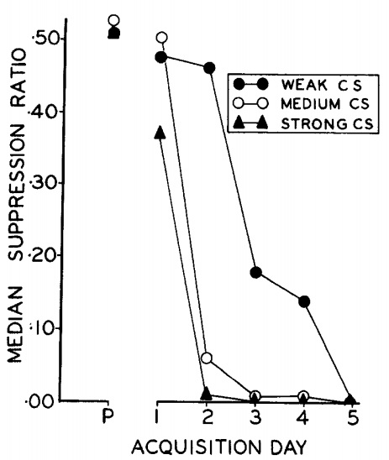
Stimulus intensity and novelty
Kamin, L. J., & Schaub, R. E. (1963). Effects of conditioned stimulus intensity on the conditioned emotional response. Journal of Comparative and Physiological Psychology, 56(3), 502–7.
CS intensity

Slide 9
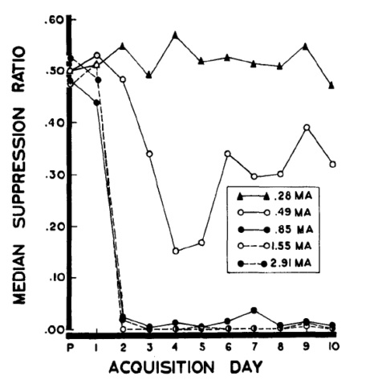
Stimulus intensity and novelty
Annau, Z., & Kamin, L. J. (1961). The conditioned emotional response as a function of intensity of the US. Journal of Comparative and Physiological Psychology, 54(4), 428–432.
US intensity

Slide 10
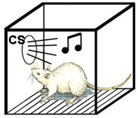
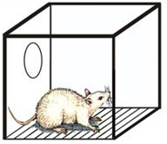
Stimulus intensity and novelty
CS-preexposure effect (also called latent inhibition)
Group 1 (prior exposure to CS)
Group 2 (no prior exposure to CS)

Slide 11
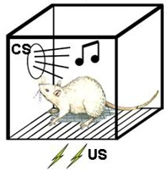
Stimulus intensity and novelty
CS-preexposure effect (also called latent inhibition)
Group 1 (prior exposure to CS)
Group 2 (no prior exposure to CS)

Slide 12
Stimulus intensity and novelty

Slide 13

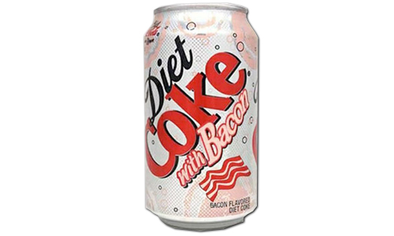
Stimulus intensity and novelty
US-preexposure effect
Monday
Tuesday
Wednesday
Thursday
Friday
CS
US

Slide 14
What are the determining conditions for Pavlovian learning?
Stimulus intensity and novelty
Number of CS-US pairings
Order of CS-US pairings
CS-US contiguity
CS-US contingency
CS-US relevance
Nasser & Delamater (2016)

Slide 15
Number of CS-US pairings
General idea: Conditioned responding increases with the number of CS-US pairings.

Slide 16
Number of CS-US pairings
General idea: Conditioned responding increases with the number of CS-US pairings.
The simple idea that conditioned responding increases with CS-US pairings turns out
to be more complicated. We will come back to this in a few weeks.

Slide 17
What are the determining conditions for Pavlovian learning?
Stimulus intensity and novelty
Number of CS-US pairings
Order of CS-US pairings
CS-US contiguity
CS-US contingency
CS-US relevance
Nasser & Delamater (2016)

Slide 18
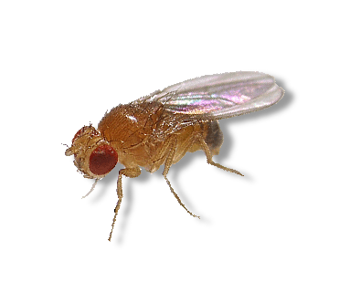
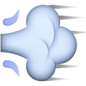
Order of CS-US pairings
Tanimoto, H., Heisenberg, M., & Gerber, B. (2004). Event timing turns punishment to reward. Nature, 430, 983.
15 s
Odor CS
3 s
Shock US
15 s
Odor CS
3 s
Shock US

Slide 19
What are the determining conditions for Pavlovian learning?
Stimulus intensity and novelty
Number of CS-US pairings
Order of CS-US pairings
CS-US contiguity
CS-US contingency
CS-US relevance
Nasser & Delamater (2016)

Slide 20
CS-US contiguity
General idea: The more closely in time the CS and US occur, the more likely they will become associated.

Slide 21
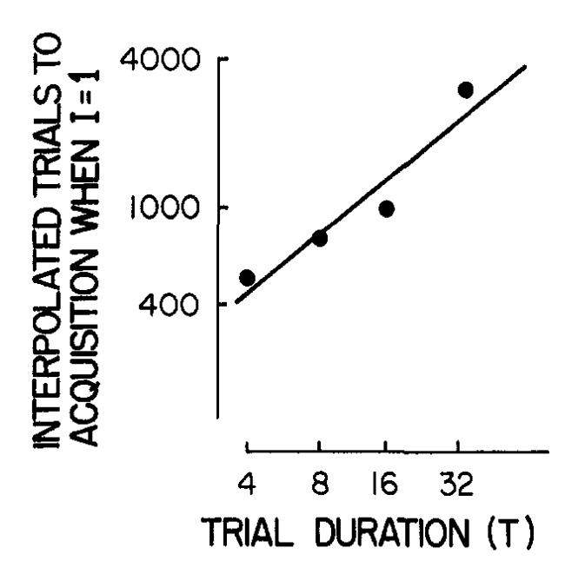
CS-US contiguity
General idea: The more closely in time the CS and US occur, the more likely they will become associated.
Number of trials
to acquisition
CS-US interval (sec)
Gibbon, J., Baldock, M. D., Locurto, C., Gold, L., & Terrace, H. S. (1977). Trial and intertrial durations in autoshaping. Journal of Experimental Psychology: Animal Behavior Processes, 3(3), 264–284.

Slide 22
CS-US contiguity
Problems for contiguity as a guiding principle of associative learning:
  - Learning with long intervals (e.g. taste aversion)
Gallistel, C. R., & Balsam, P. D. (2014). Time to rethink the neural mechanisms of learning and memory. Neurobiology of Learning and Memory, 108, 136–144.

Slide 23
CS-US contiguity
Problems for contiguity as a guiding principle of associative learning:
  - Learning with long intervals (e.g. taste aversion)
  - Simultaneous CS-US pairing is not optimal for learning.
Gallistel, C. R., & Balsam, P. D. (2014). Time to rethink the neural mechanisms of learning and memory. Neurobiology of Learning and Memory, 108, 136–144.

Slide 24
CS-US contiguity
Problems for contiguity as a guiding principle of associative learning:
  - Learning with long intervals (e.g. taste aversion)
  - Simultaneous CS-US pairing is not optimal for learning.
  - Keeping the CS-US interval constant but varying the ITI has different effects on learning (next slide).
Gallistel, C. R., & Balsam, P. D. (2014). Time to rethink the neural mechanisms of learning and memory. Neurobiology of Learning and Memory, 108, 136–144.

Slide 25
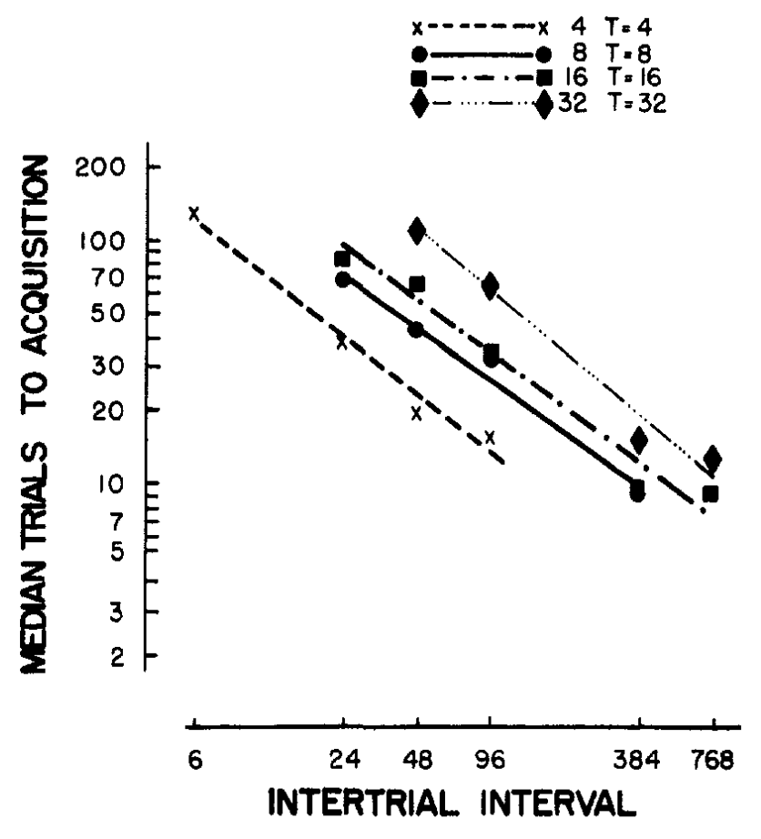
CS-US contiguity
CS-US intervals used with different groups of pigeons.
Gibbon, J., Baldock, M. D., Locurto, C., Gold, L., & Terrace, H. S. (1977). Trial and intertrial durations in autoshaping. Journal of Experimental Psychology: Animal Behavior Processes, 3(3), 264–284.

Slide 26
CS-US contiguity
Problems for contiguity as a guiding principle of associative learning:
  - Learning with long intervals (e.g. taste aversion)
  - Simultaneous CS-US pairing is not optimal for learning.
  - Keeping the CS-US interval constant but varying the ITI has different effects on learning.
  - Keeping the CS-US interval and ITI constant but varying the probability of reward during the ITI has different effects on learning. CS-US contingency matters.
Gallistel, C. R., & Balsam, P. D. (2014). Time to rethink the neural mechanisms of learning and memory. Neurobiology of Learning and Memory, 108, 136–144.

Slide 27
What are the determining conditions for Pavlovian learning?
Stimulus intensity and novelty
Number of CS-US pairings
Order of CS-US pairings
CS-US contiguity
CS-US contingency
CS-US relevance
Nasser & Delamater (2016)

Slide 28
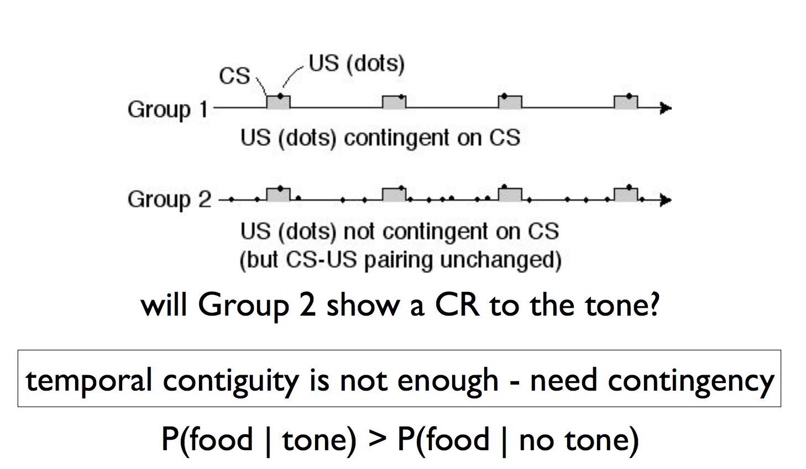
CS-US contingency
Remember Rescorla’s truly random control?

Slide 29
What are the determining conditions for Pavlovian learning?
Stimulus intensity and novelty
Number of CS-US pairings
Order of CS-US pairings
CS-US contiguity
CS-US contingency
CS-US relevance
Nasser & Delamater (2016)

Slide 30


CS-US relevance
Garcia, J., & Koelling, R. A. (1966). Relation of cue to consequence in avoidance learning. Psychonomic Science, 4(1), 123–124.
Training
Saccharine-flavored water + noise/flash
Saccharine-flavored water + noise/flash

Slide 31
CS-US relevance
Garcia, J., & Koelling, R. A. (1966). Relation of cue to consequence in avoidance learning. Psychonomic Science, 4(1), 123–124.
Test
Saccharine-flavored water + no noise/flash
or...
Plain water + noise/flash

Slide 32
CS-US relevance
Garcia, J., & Koelling, R. A. (1966). Relation of cue to consequence in avoidance learning. Psychonomic Science, 4(1), 123–124.
Study Design (4 groups)
Test = Taste
Test = Audiovisual
Trained with shock Tested with sweet water + no noise/flash | Trained with shock Tested with plain water + noise/flash
Trained with illness Tested with sweet water + no noise/flash | Trained with illness Tested with plain water + noise/flash
US = Shock
US = Sickness

Slide 33
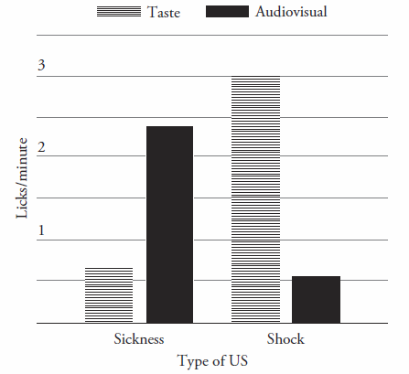
CS-US relevance
Garcia, J., & Koelling, R. A. (1966). Relation of cue to consequence in avoidance learning. Psychonomic Science, 4(1), 123–124.

Slide 34
CS-US relevance
Garcia, J., & Koelling, R. A. (1966). Relation of cue to consequence in avoidance learning. Psychonomic Science, 4(1), 123–124.
Conditioning sickness was easier when the CS was a taste.
Conditioning fear was easier when the CS was audio/visual.

