Slide 1
PSYC 3510 – Lecture 4

Slide 2
Pavlovian Conditioning Procedures
Components of a Pavlovian conditioning experiment:
Sessions
Blocks
Trials

Slide 3
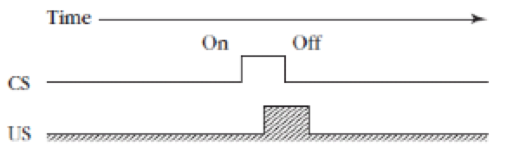
Pavlovian Conditioning Procedures
One trial

Slide 4
Pavlovian Conditioning Procedures
A block of four trials

Slide 5
Pavlovian Conditioning Procedures
A session of three blocks

Slide 6
Pavlovian Conditioning Procedures

Slide 7
Pavlovian Conditioning Procedures

Slide 8
Pavlovian Conditioning Procedures

Slide 9
Pavlovian Conditioning Procedures
CS-US interval

Slide 10
Pavlovian Conditioning Procedures
Inter-trial interval (ITI)

Slide 11
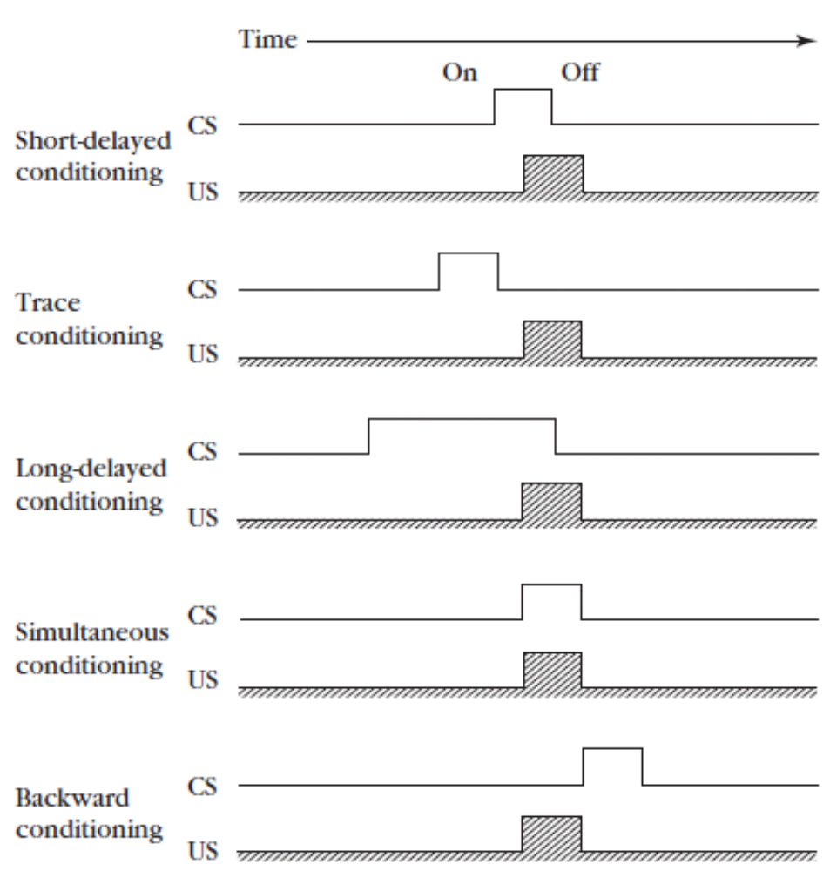
Pavlovian Conditioning Procedures

Slide 12
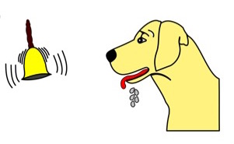

Pavlovian Conditioning Procedures
Measuring the conditioned response (during a ‘test trial’)
  - Magnitude
vs.

Slide 13
Pavlovian Conditioning Procedures
Measuring the conditioned response (during a ‘test trial’)
  - Magnitude
  - Frequency
Trial 1
Trial 2
Trial 3

Slide 14
Pavlovian Conditioning Procedures
Measuring the conditioned response (during a ‘test trial’)
  - Magnitude
  - Frequency
  - Latency
0 s
0.1 s
0.2 s
0.3 s

Slide 15
Pavlovian Conditioning Procedures
How do we really know if a CS-US association exists?

Slide 16
Pavlovian Conditioning Procedures
How do we really know if a CS-US association exists?
“Unpaired” control group

Slide 17
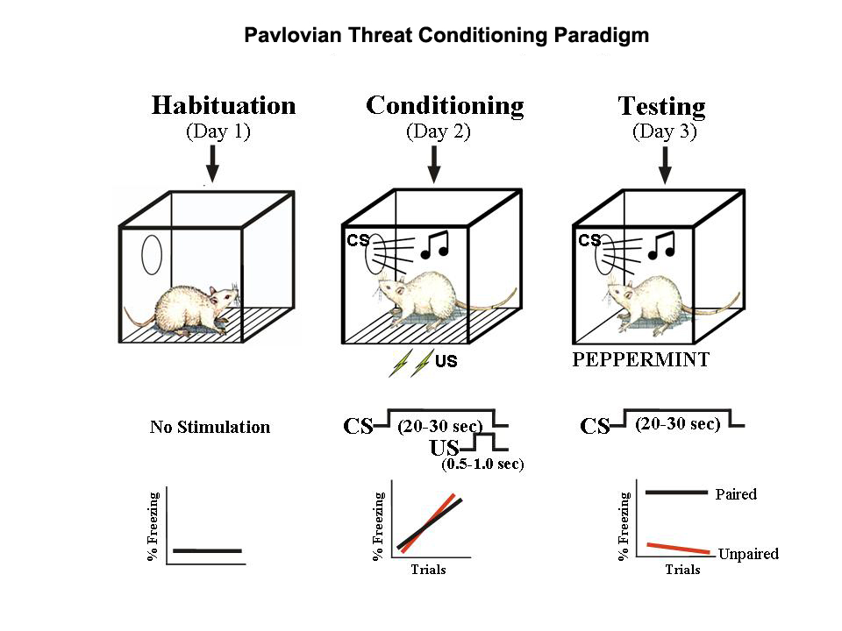
Pavlovian Conditioning Procedures
CS presented at random times throughout session. No shocks are given.

Slide 18
Inhibitory Conditioning
Excitatory conditioning involves predicting the US from a CS.
Inhibitory conditioning involves predicting the absence of the US from a CS.

Slide 19
Inhibitory Conditioning
Pavlov’s procedure for conditioned inhibition.
A+
US
AB-
nothing

Slide 20
Inhibitory Conditioning
Measuring conditioned inhibition

Slide 21
Inhibitory Conditioning
Measuring conditioned inhibition
  - Summation test

Slide 22
Inhibitory Conditioning
Measuring conditioned inhibition
  - Summation test
Acquisition
Test
A+
US
BX-
nothing
B+
US
AX-
nothing
If responding to BX- is lower than B+ from the outset of the test phase, then X- is said to be a conditioned inhibitor.

Slide 23
Inhibitory Conditioning
Measuring conditioned inhibition
  - Retardation of acquisition test

Slide 24
Inhibitory Conditioning
Measuring conditioned inhibition
  - Retardation of acquisition test
Acquisition
Test
A+
US
X+
US
B+
US
Y+
US
AX-
nothing
If X developed conditioned inhibition during the acquisition phase, then it should take longer to acquire responding to X than Y during the test phase.

