Slide 1
PSYC 3510 – Lecture 8

Slide 2
Operant conditioning
Three components of operant conditioning:
- Response
- Reinforcer
- Response-Reinforcer Relationship

Slide 3
Responses
What types of responses can be reinforced?
https://www.youtube.com/watch?v=jAQSEO25fa4
https://www.youtube.com/watch?v=TtfQlkGwE2U

Slide 4
Responses
Reinforcement often leads to repetition…

Slide 5
Responses
Reinforcement often leads to repetition…
but randomness itself can be reinforced!

Slide 6
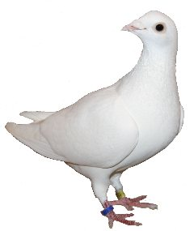
Responses
Reinforcement often leads to repetition…
but randomness itself can be reinforced!
________________________________________________
All possible 4-key sequences:
LLLL
LLLR
LLRR
LRRR
RRRR
RRRL
RRLL
RLLL
RRRR
RLRL
LRLR
RLRR
LRLL
.
.
…. 2⁴ = 16 combinations
Left
Right
Magazine
Page & Neuringer (1985)

Slide 7
Responses
Reinforcement often leads to repetition…
but randomness itself can be reinforced!
________________________________________________
Ongoing sample of behavior:
…LLRLLRRRRRLRRLLRLLLLRRL…
Page & Neuringer (1985)

Slide 8
Responses
Reinforcement often leads to repetition…
but randomness itself can be reinforced!
________________________________________________
Ongoing sample of behavior:
…LLRLLRRRRRLRRLLRLLLLRRL…
If the most recent 4-peck sequence has not been performed within the last n sequences, then the pigeon is rewarded.
Page & Neuringer (1985)

Slide 9
Responses
Reinforcement often leads to repetition…
but randomness itself can be reinforced!
________________________________________________
Two groups
Variable Group
If the most recent 4-peck sequence has not been performed within the last n sequences, then the pigeon is rewarded.
Yolked Group
Pigeons are ‘yolked’ to a pigeon in the Variable Group such that if the Variable pigeon is rewarded, the Yoked pigeon will also receive reward regardless of its sequence of key pecks.
*The yolked pigeons still need to peck for rewards, but rewards do not depend on how variable the pecks are.
Page & Neuringer (1985)

Slide 10
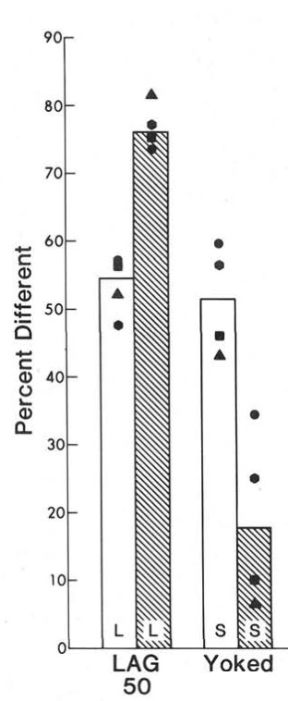

Responses
Pecking variability
Page & Neuringer (1985)

Slide 11
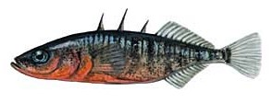
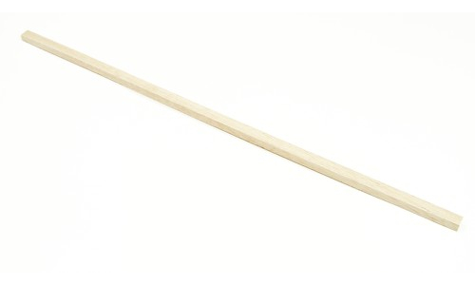
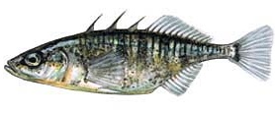

Responses
Evolutionary constraints on reinforcement…
Male
Female

Slide 12
Responses
Evolutionary constraints on reinforcement…
Male
Female

Slide 13
Responses
Evolutionary constraints on reinforcement…
Male
Male

Slide 14
Responses
Evolutionary constraints on reinforcement…
Male
Male

Slide 15
Reinforcers
General principle: The higher the quality and quantity of the reinforcer, the higher the response rate.

Slide 16
Reinforcers
General principle: The higher the quality and quantity of the reinforcer, the higher the response rate.
…but…

Slide 17
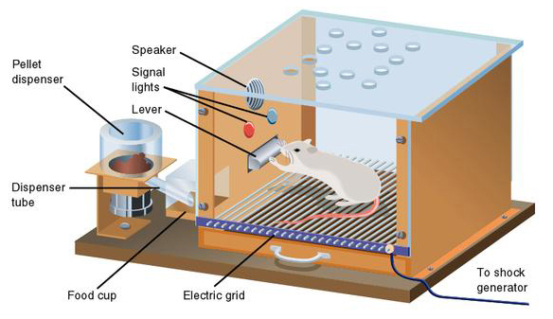
Reinforcers
Caveat #1
Pressing rates will level off or even decrease once the reward magnitude becomes too high. Why?

Slide 18
Reinforcers
Caveat #1
The animal will not be able to afford pressing—it will be spending the majority of its time in the magazine consuming the rewards.

Slide 19
Reinforcers
Caveat #2
Weber-Fechner Law:
The value of a reward grows in a negatively accelerating fashion as a function of its magnitude.

Slide 20
Reinforcers
Caveat #2
Weber-Fechner Law:
For greater magnitudes of reward, there are smaller and smaller changes in perceived value.

Slide 21
Reinforcers
Caveat #2
Weber-Fechner Law:
For greater magnitudes of reward, there are smaller and smaller changes in perceived value.
1 vs. 2 pellets
≠
10 vs. 11 pellets

