Slide 1
PSYC 3510 – Lecture 7

Slide 2
Operant conditioning
Pavlovian conditioning is the process by which organisms associate stimuli with other stimuli.
Operant conditioning is the process by which organisms associate actions with stimuli.

Slide 3
Operant conditioning

Slide 4
Operant conditioning
Conditioning animals using reinforcement
https://www.youtube.com/watch?v=I_ctJqjlrHA

Slide 5
Operant conditioning
Conditioning artificial agents using reinforcement
https://www.bloomberg.com/features/2015-preschool-for-robots/ (1:10 – 4:30)
https://www.youtube.com/watch?v=CIF2SBVY-J0
https://www.youtube.com/watch?v=gn4nRCC9TwQ

Slide 6
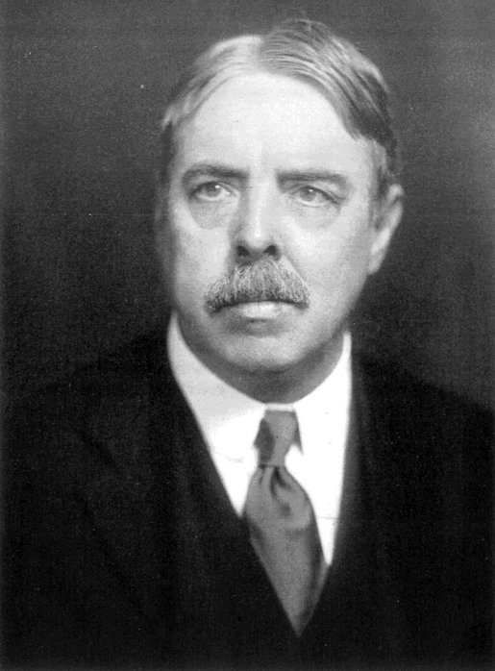
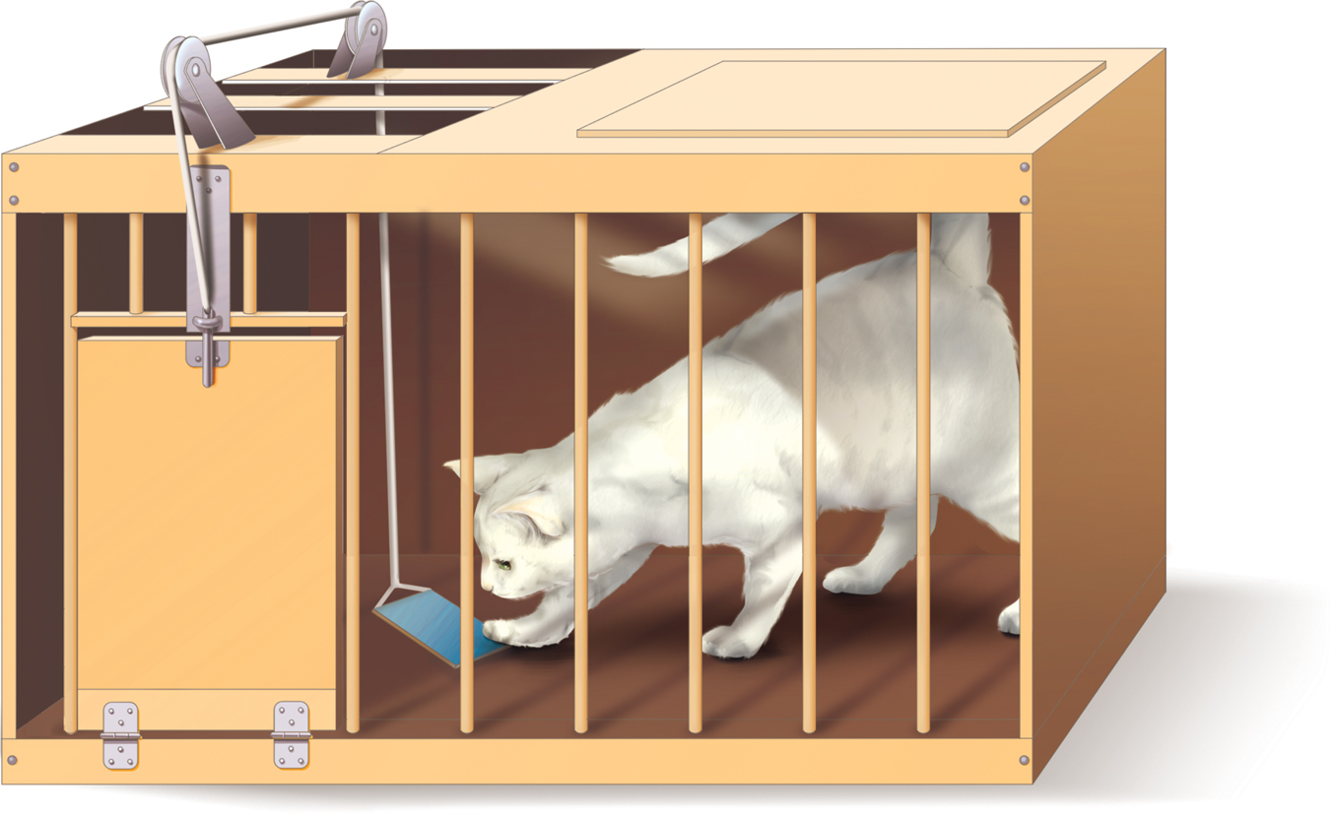
Operant conditioning
Law of Effect: If a response (R) in the presence of a stimulus (S) is followed by a satisfying event, then the association between S and R becomes strengthened.
Edward Thorndike

Slide 7
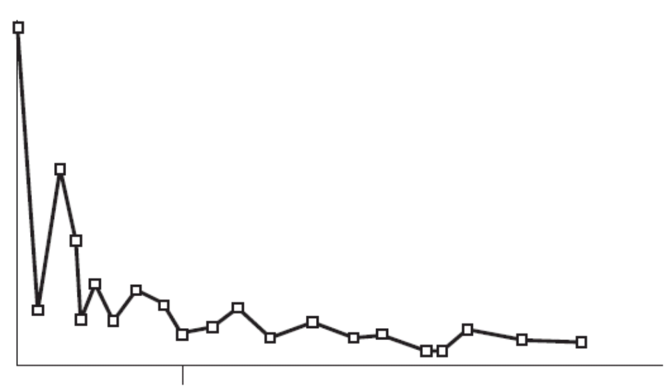
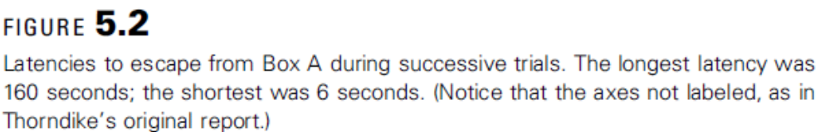
Operant conditioning

Slide 8
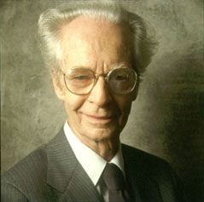
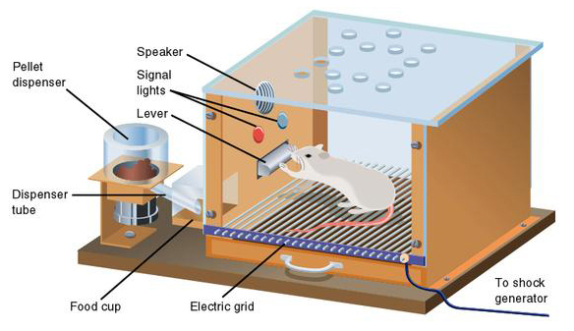
Operant conditioning
Operant Response: An action that has some consequence on an animal’s environment.
B.F. Skinner

Slide 9
Operant conditioning
Terminology
Positive reinforcement: Occurs when an action produces an appetitive stimulus and repetition of a behavior.

Slide 10
Operant conditioning
Terminology
Positive reinforcement: Occurs when an action produces an appetitive stimulus and repetition of a behavior.
Negative reinforcement: Occurs when an action prevents an aversive stimulus and produces repetition of a behavior.

Slide 11
Operant conditioning
Terminology
Positive reinforcement: Occurs when an action produces an appetitive stimulus and repetition of a behavior.
Negative reinforcement: Occurs when an action prevents an aversive stimulus and produces repetition of a behavior.
Positive punishment: Occurs when an action produces an aversive stimulus and avoidance of a behavior.

Slide 12
Operant conditioning
Terminology
Positive reinforcement: Occurs when an action produces an appetitive stimulus and repetition of a behavior.
Negative reinforcement: Occurs when an action prevents an aversive stimulus and produces repetition of a behavior.
Positive punishment: Occurs when an action produces an aversive stimulus and avoidance of a behavior.
Negative punishment: Occurs when an action prevents an appetitive stimulus and produces avoidance of a behavior.

Slide 13
In-class writing
  There is someone in your life that you frequently lend money to. To get them to pay you back, you have two options:
  Promise to lend them more money in the future (positive reinforcement).
  Threaten to charge a late fee (negative reinforcement).
  Is one type of reinforcement more effective than the other? Why?

