Slide 1

Rescorla & Wagner (1972)
∆V= α(λ - V_{total})

Slide 2
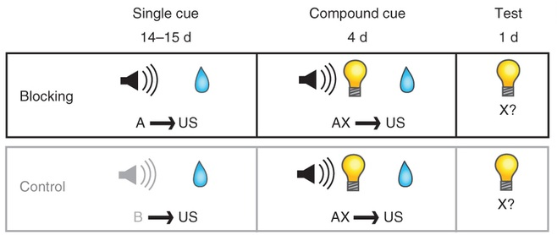
Blocking

Slide 3
Blocking

Slide 4
Blocking
Conditioning to one element of the compound is reduced (or blocked) if the other element has already been established as a reliable predictor of reward.

Slide 5
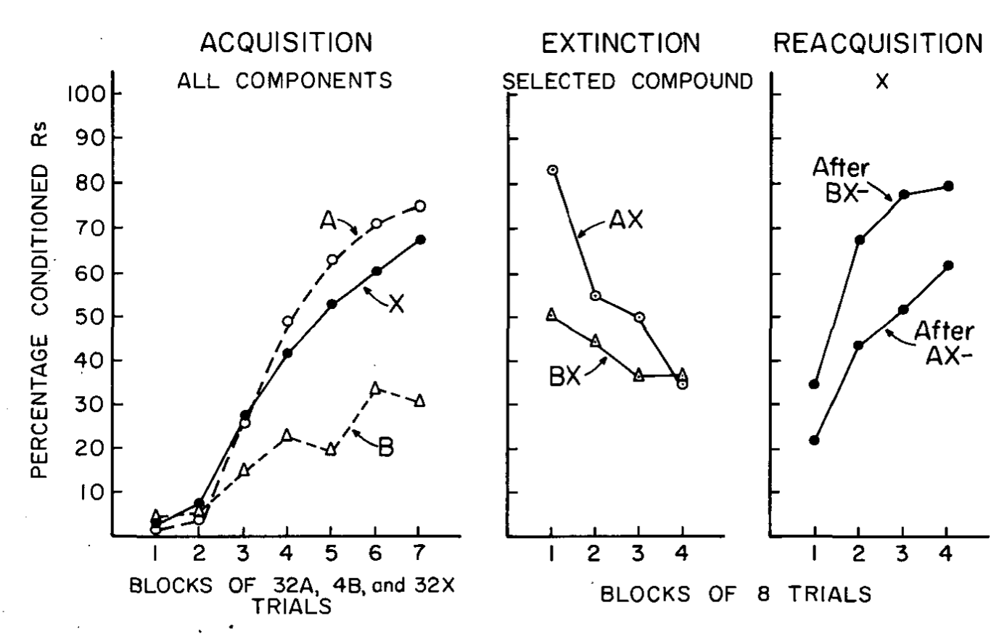
Wagner (1969)
Eyeblink conditioning in the rabbit

Slide 6
Wagner (1969)
Eyeblink conditioning in the rabbit

Slide 7
Wagner (1969)
Separate groups of rabbits
Eyeblink conditioning in the rabbit

Slide 8
Wagner (1969)
Eyeblink conditioning in the rabbit

Slide 9
Wagner (1969)
Eyeblink conditioning in the rabbit

Slide 10
Wagner (1969)
“[T]he ‘decremental’ effects of nonreinforcement are greater, the greater the net associative strength of all the cues which precede the nonreinforcement”.

Slide 11
The Model

Slide 12
The Model
The model needs to capture the following features of Pavlovian conditioning:

Slide 13
The Model
The model needs to capture the following features of Pavlovian conditioning:
- A stimulus will gain a lot of associative strength if it is reinforced and embedded in a composite of other stimuli which do not collectively hold high associative strength.

Slide 14
The Model
The model needs to capture the following features of Pavlovian conditioning:
- A stimulus will gain a lot of associative strength if it is reinforced and embedded in a composite of other stimuli which do not collectively hold high associative strength.
- A stimulus will not gain a lot of associative strength if it is reinforced and embedded in a composite of other stimuli which do collectively hold high associative strength.

Slide 15
The Model
The model needs to capture the following features of Pavlovian conditioning:
- A stimulus will gain a lot of associative strength if it is reinforced and embedded in a composite of other stimuli which do not collectively hold high associative strength.
- A stimulus will not gain a lot of associative strength if it is reinforced and embedded in a composite of other stimuli which do collectively hold high associative strength.
- A stimulus will lose a lot of associative strength if it is nonreinforced and embedded in a composite of other stimuli which do collectively hold high associative strength.

Slide 16
The Model
The model needs to capture the following features of Pavlovian conditioning:
- A stimulus will gain a lot of associative strength if it is reinforced and embedded in a composite of other stimuli which do not collectively hold high associative strength.
- A stimulus will not gain a lot of associative strength if it is reinforced and embedded in a composite of other stimuli which do collectively hold high associative strength.
- A stimulus will lose a lot of associative strength if it is nonreinforced and embedded in a composite of other stimuli which do collectively hold high associative strength.
- A stimulus will not lose a lot of associative strength if it is nonreinforced and embedded in a composite of other stimuli which do not collectively hold high associative strength.

Slide 17
The Model
Learning occurs only when there is an error in prediction!

Slide 18
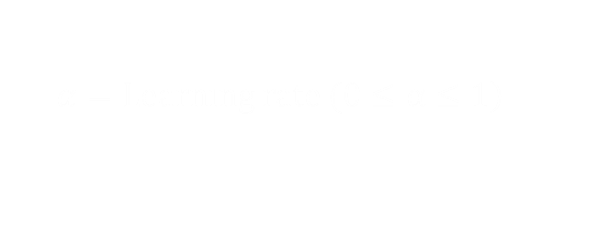



The Model
∆V= α(λ - V_{total})
$$∆V=Change in associative strength$$
$$\left.α=Learning rate (0≤α≤1\right)$$
$$λ=Absolute value of US$$
$V_{Total}=$ $Sum of associative strengths for all CS′$
$\text{λ}\text{ − }\text{Vtotal}=$ $Prediction error$

Slide 19
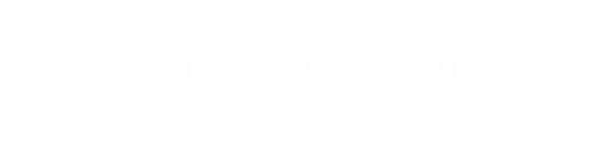



The Model
∆V= α(λ - V_{total})
$$∆V=Change in associative strength$$
$$\left.α=Learning rate (0≤α≤1\right)$$
$$λ=Absolute value of US$$
$V_{Total}=$ $Sum of associative strengths for all CS′$
$\text{λ}\text{ − }\text{Vtotal}=$ $Prediction error$
Explanation of blocking
Phase 1 (A+)
α = 0.2, λ = 1
Trial number | V_{old} | λ - V_{total} | V_{new}
1 | 0 | 1 | 0.2

Slide 20
The Model
∆V= α(λ - V_{total})
$$∆V=Change in associative strength$$
$$\left.α=Learning rate (0≤α≤1\right)$$
$$λ=Absolute value of US$$
$V_{Total}=$ $Sum of associative strengths for all CS′$
$\text{λ}\text{ − }\text{Vtotal}=$ $Prediction error$
Explanation of blocking
Phase 1 (A+)
α = 0.2, λ = 1
Trial number | V_{old} | λ - V_{total} | V_{new}
1 | 0 | 1 | 0.2
2 | 0.2 | 0.8 | 0.36
3 | 0.36 | 0.64 | 0.49
4 | 0.49 | 0.51 | 0.59
5 | 0.59 | 0.41 | 0.67
6 | 0.67 | 0.33 | 0.74

Slide 21
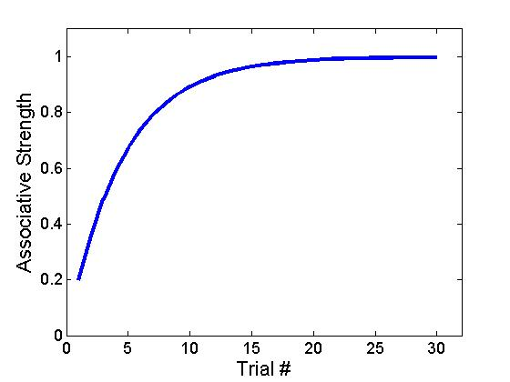
The Model
∆V= α(λ - V_{total})
$$∆V=Change in associative strength$$
$$\left.α=Learning rate (0≤α≤1\right)$$
$$λ=Absolute value of US$$
$V_{Total}=$ $Sum of associative strengths for all CS′$
$\text{λ}\text{ − }\text{Vtotal}=$ $Prediction error$
Trial number | V_{old} | λ - V_{total} | V_{new}
1 | 0 | 1 | 0.2
2 | 0.2 | 0.8 | 0.36
3 | 0.36 | 0.64 | 0.49
4 | 0.49 | 0.51 | 0.59
5 | 0.59 | 0.41 | 0.67
6 | 0.67 | 0.33 | 0.74

Slide 22
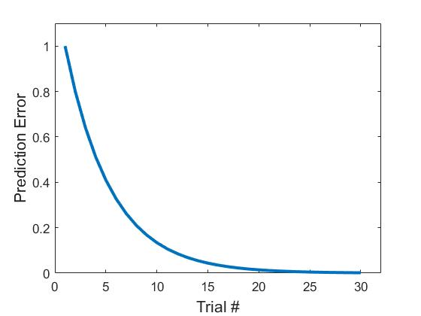
The Model
∆V= α(λ - V_{total})
$$∆V=Change in associative strength$$
$$\left.α=Learning rate (0≤α≤1\right)$$
$$λ=Absolute value of US$$
$V_{Total}=$ $Sum of associative strengths for all CS′$
$\text{λ}\text{ − }\text{Vtotal}=$ $Prediction error$
Trial number | V_{old} | λ - V_{total} | V_{new}
1 | 0 | 1 | 0.2
2 | 0.2 | 0.8 | 0.36
3 | 0.36 | 0.64 | 0.49
4 | 0.49 | 0.51 | 0.59
5 | 0.59 | 0.41 | 0.67
6 | 0.67 | 0.33 | 0.74

Slide 23
The Model
∆V= α(λ - V_{total})
$$∆V=Change in associative strength$$
$$\left.α=Learning rate (0≤α≤1\right)$$
$$λ=Absolute value of US$$
$V_{Total}=$ $Sum of associative strengths for all CS′$
$\text{λ}\text{ − }\text{Vtotal}=$ $Prediction error$
Explanation of blocking
Phase 2 (AX+)
α = 0.2, λ = 1
A
X
Trial number | V_{old} | V_{total} | λ - V_{total} | V_{new}
7 | 0.74 | 0.74+0 | 0.26 | 0.79
8 | 0.79 | 0.79+0.05 | 0.16 | 0.82
9 | 0.82 | 0.82+0.08 | 0.1 | 0.84
Trial number | V_{old} | V_{total} | λ - V_{total} | V_{new}
7 | 0 | 0.74+0 | 0.26 | 0.05
8 | 0.05 | 0.79+0.05 | 0.16 | 0.08
9 | 0.08 | 0.82+0.08 | 0.1 | 0.1

Slide 24

The Model
∆V= α(λ - V_{total})
$$∆V=Change in associative strength$$
$$\left.α=Learning rate (0≤α≤1\right)$$
$$λ=Absolute value of US$$
$V_{Total}=$ $Sum of associative strengths for all CS′$
$\text{λ}\text{ − }\text{Vtotal}=$ $Prediction error$
Explanation of blocking
Phase 2 (AX+)
α = 0.2, λ = 1
A
X
Trial number | V_{old} | V_{total} | λ - V_{total} | V_{new}
7 | 0.74 | 0.74+0 | 0.26 | 0.79
8 | 0.79 | 0.79+0.05 | 0.16 | 0.82
9 | 0.82 | 0.82+0.08 | 0.1 | 0.84
Trial number | V_{old} | V_{total} | λ - V_{total} | V_{new}
7 | 0 | 0.74+0 | 0.26 | 0.05
8 | 0.05 | 0.79+0.05 | 0.16 | 0.08
9 | 0.08 | 0.82+0.08 | 0.1 | 0.1

Slide 25
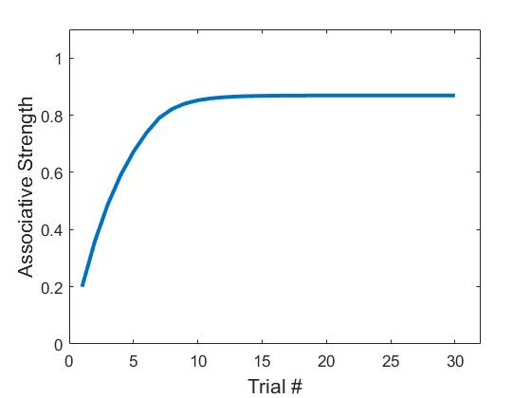
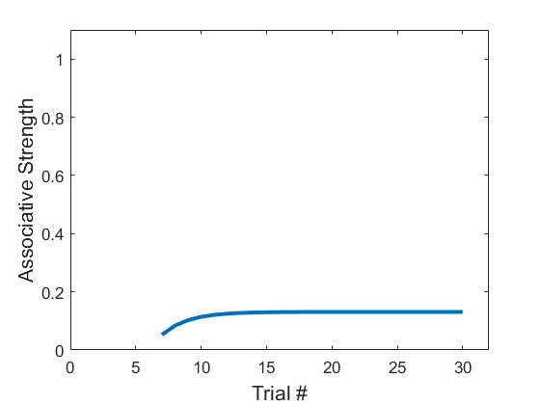

The Model
∆V= α(λ - V_{total})
$$∆V=Change in associative strength$$
$$\left.α=Learning rate (0≤α≤1\right)$$
$$λ=Absolute value of US$$
$V_{Total}=$ $Sum of associative strengths for all CS′$
$\text{λ}\text{ − }\text{Vtotal}=$ $Prediction error$
Explanation of blocking
A
X

Slide 26

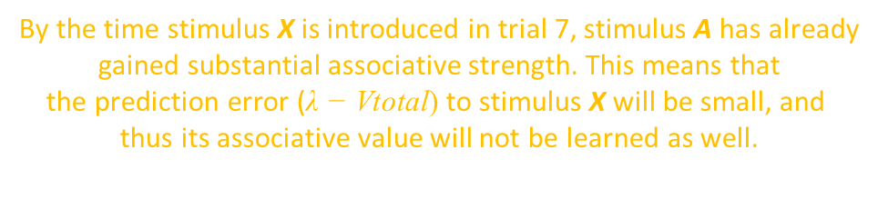


The Model
∆V= α(λ - V_{total})
$$∆V=Change in associative strength$$
By the time stimulus X is introduced in trial 7, stimulus A has already
gained substantial associative strength. This means that
the prediction error ($\text{λ}\text{ − }\text{Vtotal}$) to stimulus X will be small, and
thus its associative value will not be learned as well.
$$\left.α=Learning rate (0≤α≤1\right)$$
$$λ=Absolute value of US$$
$V_{Total}=$ $Sum of associative strengths for all CS′$
$\text{λ}\text{ − }\text{Vtotal}=$ $Prediction error$
Explanation of blocking
A
X

Slide 27

The Model
∆V= α(λ - V_{total})
Takahashi et al. (2009). The orbitofrontal cortex and ventral tegmental area are necessary for learning from unexpected outcomes. Neuron, 62(2), 269–80.
$$∆V=Change in associative strength$$
$$\left.α=Learning rate (0≤α≤1\right)$$
$$λ=Absolute value of US$$
$V_{Total}=$ $Sum of associative strengths for all CS′$
$\text{λ}\text{ − }\text{Vtotal}=$ $Prediction error$
Weird model predictions
A₁+ (10)
V₁+ (10)
A₂+ (10)
A₃- (10)
A₁V₁+ (4)
A₂+ (4)
A₃- (4)
A₁?
A₂?
A₃?

Slide 28
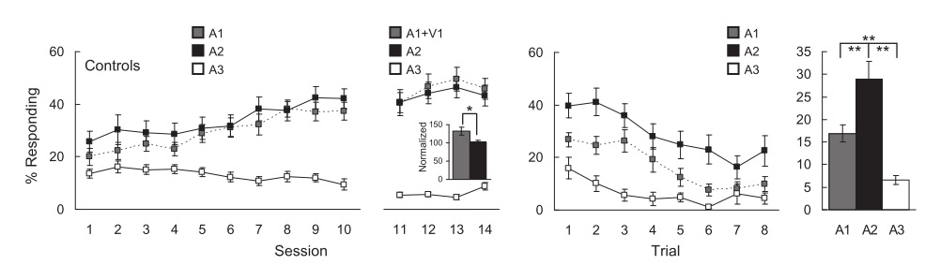
The Model
∆V= α(λ - V_{total})
Takahashi et al. (2009). The orbitofrontal cortex and ventral tegmental area are necessary for learning from unexpected outcomes. Neuron, 62(2), 269–80.
$$∆V=Change in associative strength$$
$$\left.α=Learning rate (0≤α≤1\right)$$
$$λ=Absolute value of US$$
$V_{Total}=$ $Sum of associative strengths for all CS′$
$\text{λ}\text{ − }\text{Vtotal}=$ $Prediction error$
Weird model predictions
A₁+ (10)
V₁+ (10)
A₂+ (10)
A₃- (10)
A₁V₁+ (4)
A₂+ (4)
A₃- (4)
A₁?
A₂?
A₃?

Slide 29
The Model
∆V= α(λ - V_{total})
Takahashi et al. (2009). The orbitofrontal cortex and ventral tegmental area are necessary for learning from unexpected outcomes. Neuron, 62(2), 269–80.
$$∆V=Change in associative strength$$
$$\left.α=Learning rate (0≤α≤1\right)$$
$$λ=Absolute value of US$$
The combined associative strengths of A₁ and V₁ in the compound phase induced an overexpectation of reward (V_{total} exceeded λ). When that overexpectation was not met, it produced a negative prediction error, and thus a decrement in associative strength.
$V_{Total}=$ $Sum of associative strengths for all CS′$
$\text{λ}\text{ − }\text{Vtotal}=$ $Prediction error$
Weird model predictions
A₁+ (10)
V₁+ (10)
A₂+ (10)
A₃- (10)
A₁V₁+ (4)
A₂+ (4)
A₃- (4)
A₁?
A₂?
A₃?

Slide 30
Dopamine neurons encode prediction errors!
…although the data are explained by a more sophisticated algorithm than the RW model.

Slide 31
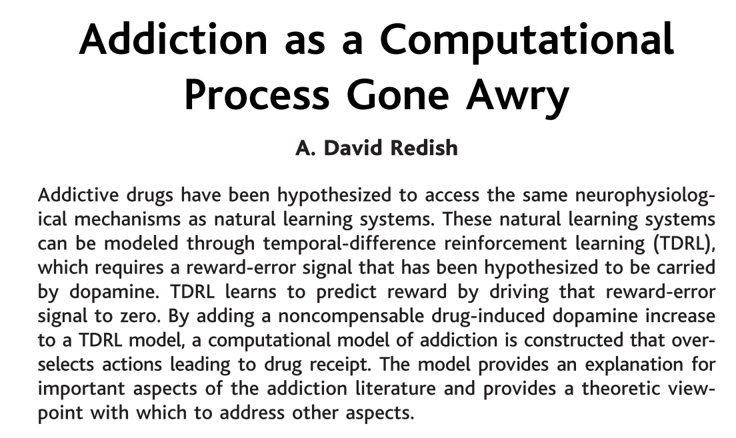
Dopamine encodes prediction errors, and addictive drugs increase dopamine levels.

Slide 32
Dopamine encodes prediction errors, and addictive drugs increase dopamine levels.
Is it possible to explain addiction in terms of prediction errors?

Slide 33
Dopamine encodes prediction errors, and addictive drugs increase dopamine levels.
Is it possible to explain addiction in terms of prediction errors?
The stimuli that are associated with drug intake are capable of acquiring infinite associative strength because drug intake produces a surge in dopamine, which means that the prediction error at the time of drug intake will always be positive.

Slide 34
Drug addiction is simply a case of getting tricked into believing the state of the world is better than expected, even when it is not.

Slide 35
Failures of the Model

Slide 36
Failures of the Model
Extinction of conditioned inhibition
A+
US
AB-
nothing

Slide 37
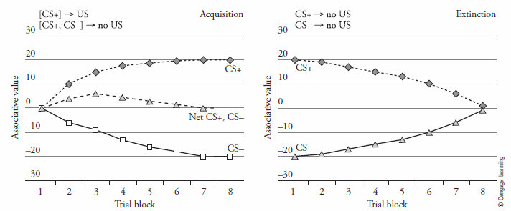
Failures of the Model
Extinction of conditioned inhibition
A+
US
AB-
nothing
A+
AB-
B-

Slide 38
Failures of the Model
Extinction of conditioned inhibition
A+
US
AB-
nothing
A+
AB-
Inferred
B-

Slide 39
Failures of the Model
Extinction of conditioned inhibition
A+
US
AB-
nothing
A+
A-
AB-
B-
B-

Slide 40
Failures of the Model
Extinction of conditioned inhibition
Extinguishing the conditioned inhibitor (B-) does not actually result in a return to neutrality (i.e. an associative strength of 0).
A+
US
AB-
nothing
A+
A-
AB-
B-
B-

