Slide 1
PSYC 3510 – Lecture 2

Slide 2
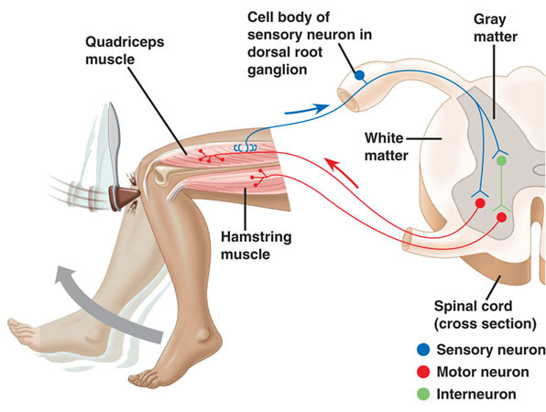
Elicited behavior
Simple reflexes

Slide 3
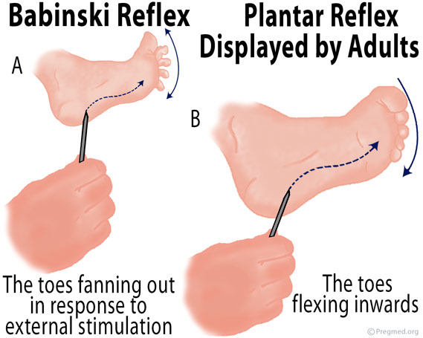
Elicited behavior
Simple reflexes

Slide 4
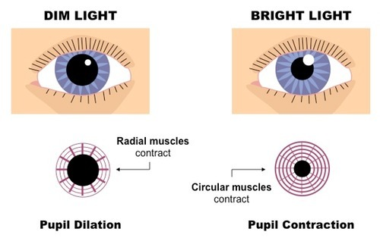
Elicited behavior
Simple reflexes

Slide 5
Elicited behavior
Complex reflexes (i.e. modal action patterns)

Slide 6
Elicited behavior
Complex reflexes (i.e. modal action patterns)
  - Stereotyped sequences
  - Species-specific

Slide 7
Elicited behavior
Complex reflexes (i.e. modal action patterns)
  - Stereotyped sequences
  - Species-specific
Herring gulls
  - https://www.youtube.com/watch?v=Th1SVdrubsY
Toads
- https://www.youtube.com/watch?v=l3Es9cNH7I8

Slide 8
Elicited behavior
Complex reflexes (i.e. modal action patterns)
  - Stereotyped sequences
  - Species-specific
Herring gulls
  - https://www.youtube.com/watch?v=Th1SVdrubsY
Toads
- https://www.youtube.com/watch?v=l3Es9cNH7I8
Input Output
Sign stimulus
Releasing mechanism
Modal action pattern

Slide 9
Repeated stimulation
How can reflexes be modified over time?

Slide 10
Repeated stimulation
How can reflexes be modified over time?
Simplest form of learning. Even single-celled organisms show modification of reflexes with repeated stimulation

Slide 11
Repeated stimulation
Habituation
  - Decline in behavioral responding that occurs with repeated stimulation

Slide 12
Repeated stimulation
Habituation
  - Decline in behavioral responding that occurs with repeated stimulation
Sensitization
  - Increase in behavioral responding that occurs with repeated stimulation

Slide 13

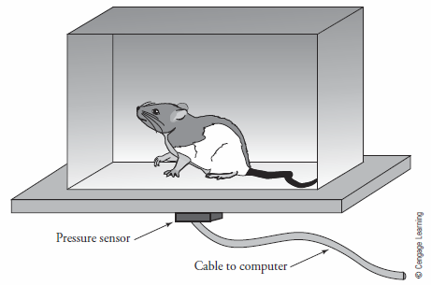
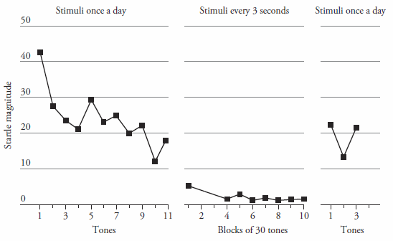
Habituation
Leaton, R.N. (1976). Long-Term Retention of the Habituation of Lick Suppression and Starte Response Produced by a Single Auditory Stimulus. Journal of Experimental Psychology: Animal Behavior Processes, 2, 248-259.

Slide 14
Habituation
Leaton, R.N. (1976). Long-Term Retention of the Habituation of Lick Suppression and Starte Response Produced by a Single Auditory Stimulus. Journal of Experimental Psychology: Animal Behavior Processes, 2, 248-259.
Spontaneous recovery

Slide 15
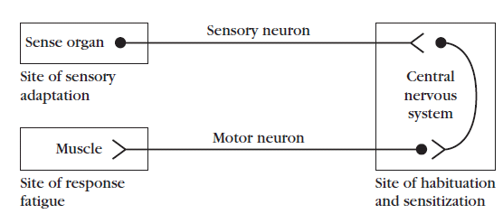
Habituation

Slide 16
Habituation
Habituation is not the same thing as sensory adaptation or fatigue.

Slide 17
Habituation
Habituation is not the same thing as sensory adaptation or fatigue.
Sensory adaptation: An adjustment of the sense organs to repeated stimulation.

Slide 18
Habituation
Habituation is not the same thing as sensory adaptation or fatigue.
Sensory adaptation: An adjustment of the sense organs to repeated stimulation.
Fatigue: An adjustment of the muscles to repeated stimulation.

Slide 19
Habituation
Habituation is not the same thing as sensory adaptation or fatigue.
Sensory adaptation: An adjustment of the sense organs to repeated stimulation.
Fatigue: An adjustment of the muscles to repeated stimulation.
Habituation is an adjustment of the central nervous system to repeated stimulation.

Slide 20
In-class writing (hypothetical)
  Here is where I would normally ask you to take out paper and write a response to a question, like:
  If a rat shows a decline in its startle response as a result of repeatedly hearing the loud sound, how could you explain this in terms of sensory adaptation? How could you explain it in terms of fatigue?

Slide 21
In-class writing (hypothetical)
  Hypothetical response:
  “The decline in the startle response may be caused by sensory adaptation or fatigue. If it is due to sensory adaptation, then the sense doing the ‘adapting’ is the hearing sense—the rat may be going deaf. If it is due to fatigue, then the rat may simply be getting tired from jumping a lot. Neither of these explanations are far-fetched, but notably they are different from an explanation that appeals to habituation”.

Slide 22
In-class writing (hypothetical)
  Here is where I would normally ask you to take out paper and write a response to a question, like:
  What is a real-life example of habituation?

Slide 23
In-class writing (hypothetical)
  Hypothetical response:
  “A real-life example of habituation is when we encounter strong odors. For example, if I walk into a smelly subway car, I will have habituated to the smell by the time I arrive at my destination. That is, I will no longer notice that it is there”.

Slide 24
Question
How can we ever know if a decline in behavioral responding over time is a result of habituation, or a result of sensory adaptation or fatigue?

Slide 25
Question
How can we ever know if a decline in behavioral responding over time is a result of habituation, or a result of sensory adaptation or fatigue?
Sensory adaptation and fatigue can be ruled out by showing that the decline in responding is stimulus-specific.

Slide 26
Question
How can we ever know if a decline in behavioral responding over time is a result of habituation, or a result of sensory adaptation or fatigue?
Sensory adaptation and fatigue can be ruled out by showing that the decline in responding is stimulus-specific.

Slide 27
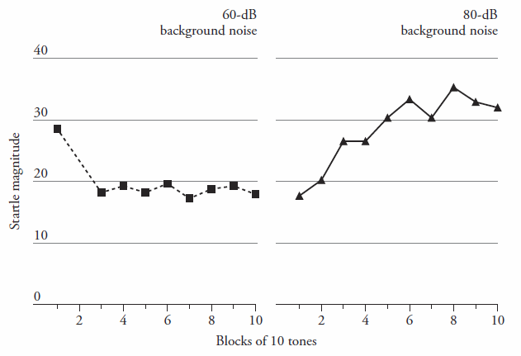
Sensitization
Davis, M. (1974). Sensitization of the Rat Startle Response by Noise. Journal of Comparative and Physiological Psychology, 571-581.

Slide 28
Opponent Process Theory
So far we have been speaking of reflexive responses, but can emotional responses be subject to habituation and sensitization?

Slide 29
Opponent Process Theory
So far we have been speaking of reflexive responses, but can emotional responses be subject to habituation and sensitization?
Think of romantic love.

Slide 30
Opponent Process Theory
So far we have been speaking of reflexive responses, but can emotional responses be subject to habituation and sensitization?
Think of romantic love.
During the first date, how do you feel?

Slide 31
Opponent Process Theory
So far we have been speaking of reflexive responses, but can emotional responses be subject to habituation and sensitization?
Think of romantic love.
During the first date, how do you feel?

Slide 32
Opponent Process Theory
So far we have been speaking of reflexive responses, but can emotional responses be subject to habituation and sensitization?
Think of romantic love.
During the first date, how do you feel?
After not seeing each other for 5 days, how do you feel?

Slide 33
Opponent Process Theory
So far we have been speaking of reflexive responses, but can emotional responses be subject to habituation and sensitization?
Think of romantic love.
During the first date, how do you feel?
After not seeing each other for 5 days, how do you feel?

Slide 34
Opponent Process Theory
So far we have been speaking of reflexive responses, but can emotional responses be subject to habituation and sensitization?
Think of romantic love.
Fast-forward 20 years…

Slide 35
Opponent Process Theory
So far we have been speaking of reflexive responses, but can emotional responses be subject to habituation and sensitization?
Think of romantic love.
When you eat together every night, how do you feel?

Slide 36
Opponent Process Theory
So far we have been speaking of reflexive responses, but can emotional responses be subject to habituation and sensitization?
Think of romantic love.
When you eat together every night, how do you feel?

Slide 37
Opponent Process Theory
So far we have been speaking of reflexive responses, but can emotional responses be subject to habituation and sensitization?
Think of romantic love.
When you eat together every night, how do you feel?
After not seeing each other for 5 days, how do you feel?

Slide 38
Opponent Process Theory
So far we have been speaking of reflexive responses, but can emotional responses be subject to habituation and sensitization?
Think of romantic love.
When you eat together every night, how do you feel?
After not seeing each other for 5 days, how do you feel?

Slide 39
Opponent Process Theory
So far we have been speaking of reflexive responses, but can emotional responses be subject to habituation and sensitization?
Think of romantic love.
First few encounters
After many encounters
Partner present
Partner absent
Partner present
Partner absent

Slide 40
Opponent Process Theory
The primary reaction is followed by an opposite after-reaction.
First few encounters
After many encounters
Partner present
Partner absent
Partner present
Partner absent

Slide 41
Opponent Process Theory
The primary reaction is followed by an opposite after-reaction.
The primary reaction becomes weaker with repeated stimulation.
First few encounters
After many encounters
Partner present
Partner absent
Partner present
Partner absent

Slide 42
Opponent Process Theory
The primary reaction is followed by an opposite after-reaction.
The primary reaction becomes weaker with repeated stimulation.
The weakening of the primary reaction with repeated stimulation is accompanied by a strengthening of the after-reaction.
First few encounters
After many encounters
Partner present
Partner absent
Partner present
Partner absent

Slide 43
Opponent Process Theory
The primary reaction is followed by an opposite after-reaction.
The primary reaction becomes weaker with repeated stimulation.
The weakening of the primary reaction with repeated stimulation is accompanied by a strengthening of the after-reaction.
The primary reaction habituates.
The after-reaction sensitizes.

Slide 44
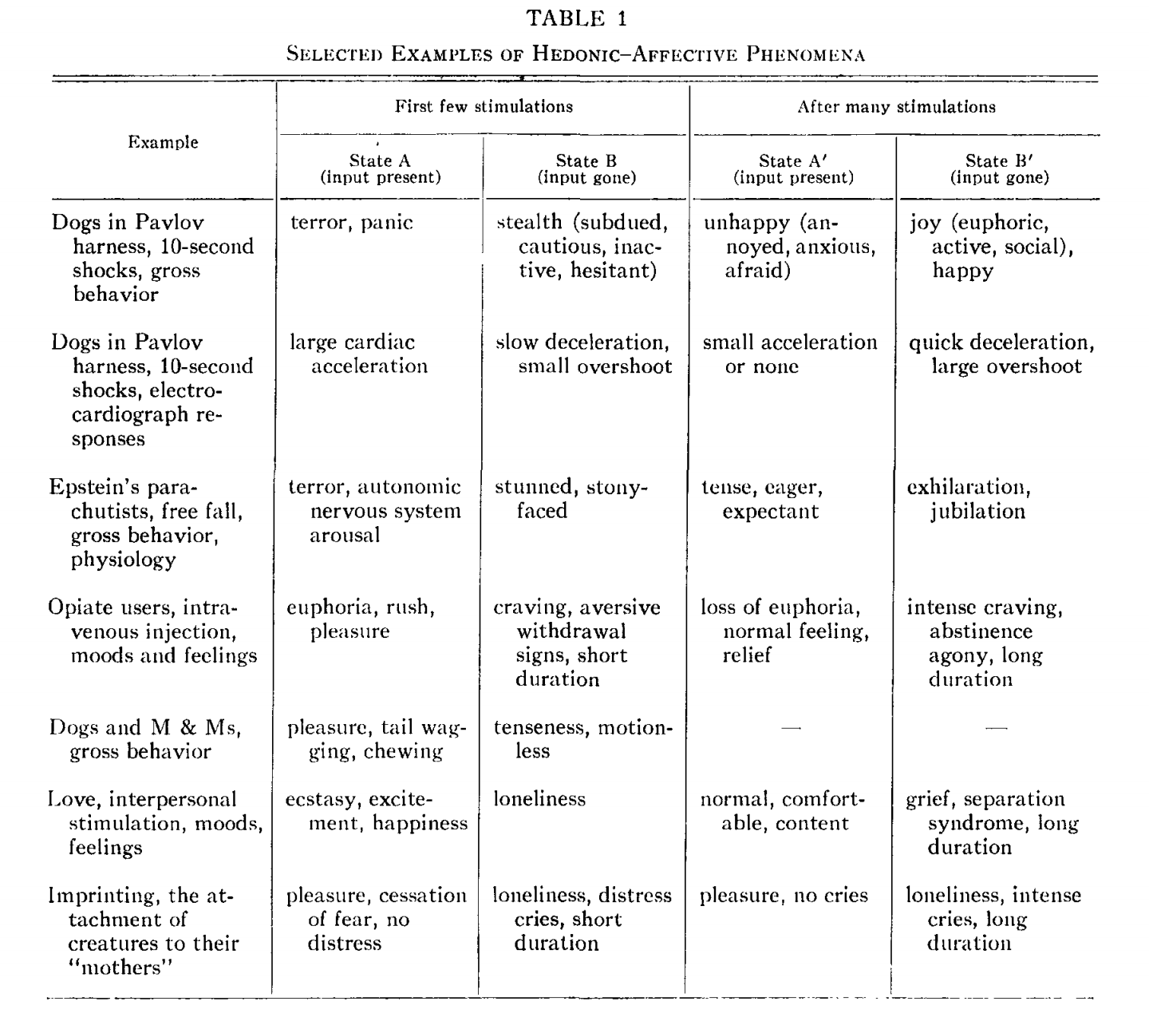
Opponent Process Theory
Solomon & Corbit (1974)

