Slide 1
PSYC 3510 – Lecture 21

Slide 2
Serial Order Learning
Response chain
1
2
3
4
5
6
Correct order: 1-3-4-6-2-5

Slide 3
Serial Order Learning
Response chain
1
2
3
4
5
6
Correct order: 1-3-4-6-2-5

Slide 4
Serial Order Learning
Response chain
1
2
3
4
5
6
Correct order: 1-3-4-6-2-5

Slide 5
Serial Order Learning
Response chain
1
2
3
4
5
6
Correct order: 1-3-4-6-2-5

Slide 6
Serial Order Learning
Response chain
1
2
3
4
5
6
Correct order: 1-3-4-6-2-5

Slide 7
Serial Order Learning
Response chain
1
2
3
4
5
6
Correct order: 1-3-4-6-2-5

Slide 8
Serial Order Learning
Response chain
1
2
3
4
5
6
Correct order: 1-3-4-6-2-5

Slide 9
Serial Order Learning
When a light turns on, that guides the animal to where it needs to press. What about when stimuli do not guide behavior, and all that is left is trial-and-error learning?
1
2
3
4
5
6
Correct order: 1-3-4-6-2-5

Slide 10
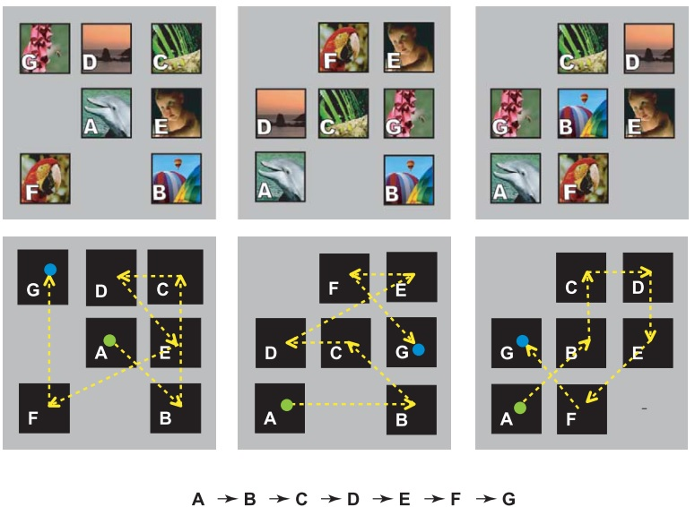
Serial Order Learning
Simultaneous chain procedure
Terrace (2005)

Slide 11
Serial Order Learning
http://www.columbia.edu/cu/psychology/primatecognitionlab/video.htm

Slide 12
Serial Order Learning
What is the animal learning in this task?

Slide 13
Serial Order Learning
What is the animal learning in this task?
Paired-associate learning: Learning to associate two successive stimuli with
each other.
A-B, B-C, C-D, D-E, E-F, F-G
B comes after A, C comes after B, etc.

Slide 14
Serial Order Learning
What is the animal learning in this task?
Paired-associate learning: Learning to associate two successive stimuli with
each other.
Serial-representation learning: Learning to represent the ordinal position
of stimuli.
A-B, B-C, C-D, D-E, E-F, F-G
B comes after A, C comes after B, etc.
A-B-C-D-E-F-G
A is first, B is second, etc.

Slide 15
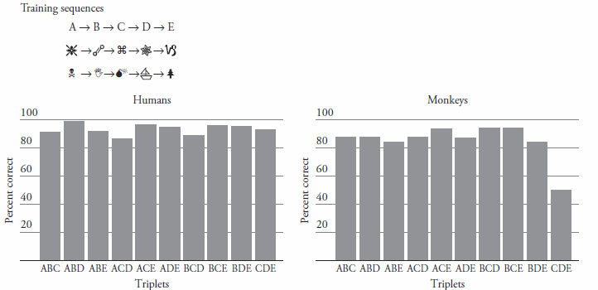
Serial Order Learning
What is the animal learning in this task?

Slide 16
Serial Order Learning
What is the animal learning in this task?
*Such proficient performance is not possible if the subjects were
merely learning stimulus-stimulus associations. Rather, humans
and monkeys seem to use serial-representation learning.

Slide 17
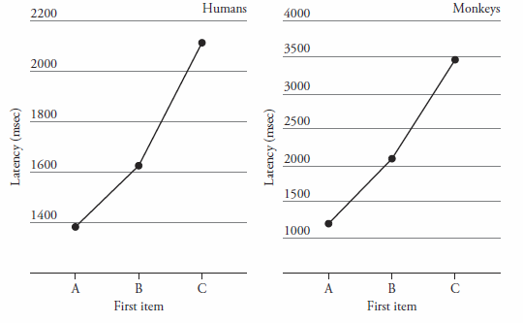
Serial Order Learning
Further evidence for serial-representation learning
Latency of the 1st response

Slide 18
Serial Order Learning
Further evidence for serial-representation learning
Latency of the 1st response
e.g.CDE
e.g. ADE
e.g. BDE

Slide 19
Serial Order Learning
Further evidence for serial-representation learning
Latency of the 1st response
*This suggests that monkeys and humans formed a mental representation of the sequence and rehearsed this sequence during the test.
e.g.CDE
e.g. ADE
e.g. BDE

Slide 20
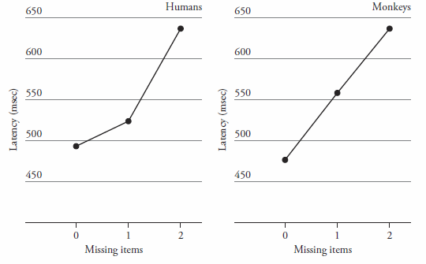
Serial Order Learning
Even further evidence for serial-representation learning
Latency of the 2nd response

Slide 21
Serial Order Learning
Even further evidence for serial-representation learning
Latency of the 2nd response
e.g.ADE
e.g. ABC
e.g. ACD

Slide 22
Serial Order Learning
Even further evidence for serial-representation learning
Latency of the 2nd response
*This suggests that monkeys and humans formed a mental representation of the sequence and rehearsed this sequence during the test.
e.g.ADE
e.g. ABC
e.g. ACD

Slide 23




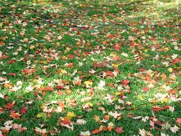



Categorization Learning

Slide 24
Categorization Learning

Slide 25
Categorization Learning
Herrnstein et al. (1976) showed pigeons up to 700 pictures over many sessions. Roughly half of the pictures contained trees, and those were the ones that were reinforced for pecking. All of the pictures were repeated at least once throughout the experiment.

Slide 26
Categorization Learning
Herrnstein et al. (1976) showed pigeons up to 700 pictures over many sessions. Roughly half of the pictures contained trees, and those were the ones that were reinforced for pecking. All of the pictures were repeated at least once throughout the experiment.
Pigeons pecked with a high degree of accuracy. Does this demonstrate that they were capable of forming a mental category of trees?

Slide 27
Categorization Learning
Herrnstein et al. (1976) showed pigeons up to 700 pictures over many sessions. Roughly half of the pictures contained trees, and those were the ones that were reinforced for pecking. All of the pictures were repeated at least once throughout the experiment.
Pigeons pecked with a high degree of accuracy. Does this demonstrate that they were capable of forming a mental category of trees?
No. They could have simply memorized which pictures resulted in reinforcement and which ones did not, without paying attention to the presence or absence of trees.

Slide 28
Categorization Learning
Herrnstein et al. (1976) showed pigeons up to 700 pictures over many sessions. Roughly half of the pictures contained trees, and those were the ones that were reinforced for pecking. All of the pictures were repeated at least once throughout the experiment.
Pigeons pecked with a high degree of accuracy. Does this demonstrate that they were capable of forming a mental category of trees?
No. They could have simply memorized which pictures resulted in reinforcement and which ones did not, without paying attention to the presence or absence of trees.
Need a transfer test in which never-before-seen images are presented.

Slide 29
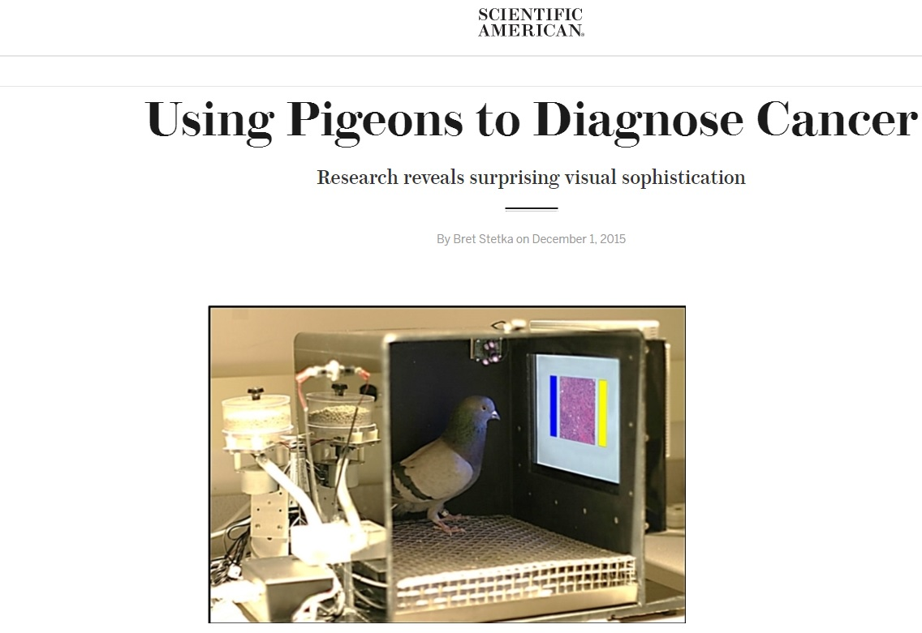
Categorization Learning

Slide 30
Categorization Learning
https://www.youtube.com/watch?v=flzGjnJLyS0

Slide 31
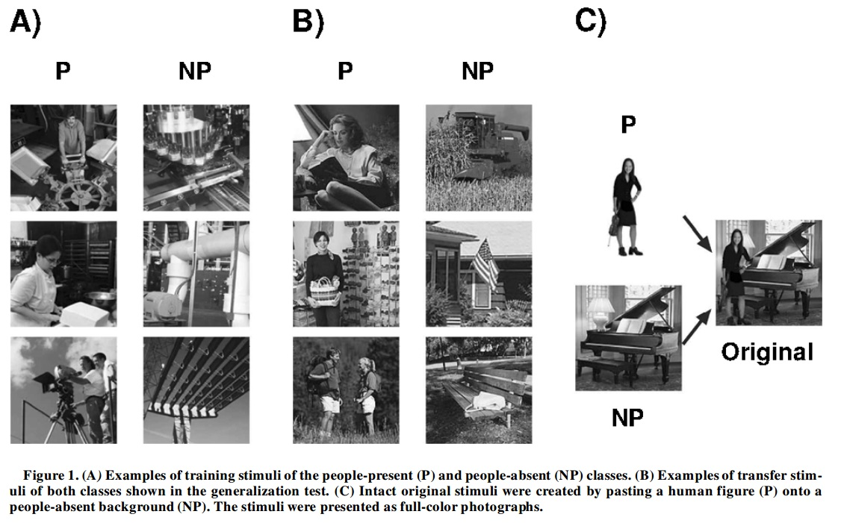
Categorization Learning
Aust & Huber (2003)

Slide 32
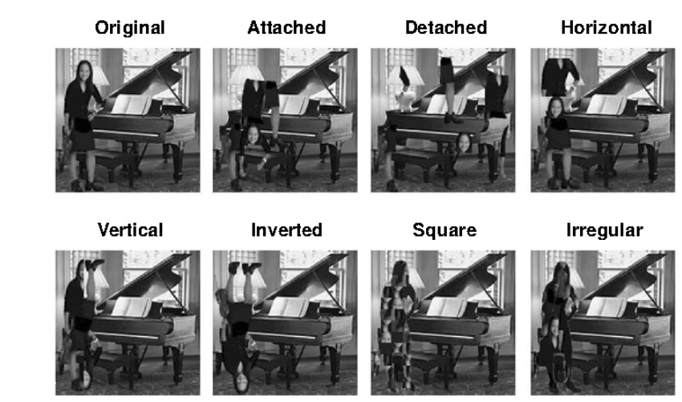
Categorization Learning
Aust & Huber (2003)

Slide 33
Categorization Learning
Pigeons were less accurate at identifying the rearranged person pictures,
but they were better compared to pictures with no person.
Animals base their categorization off of common elements.

Slide 34
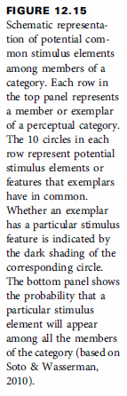
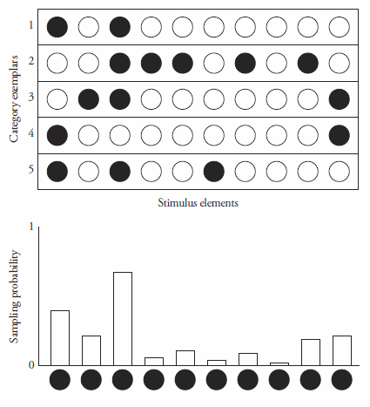
Categorization Learning
Pigeons were less accurate at identifying the rearranged person pictures,
but they were better compared to pictures with no person.
Animals base their categorization off of common elements.

Slide 35
Categorization Learning
Pigeons were less accurate at identifying the rearranged person pictures,
but they were better compared to pictures with no person.
Animals base their categorization off of common elements.
The category is best defined by the 3rd stimulus element.

