Slide 1
PSYC 3510 – Lecture 20

Slide 2
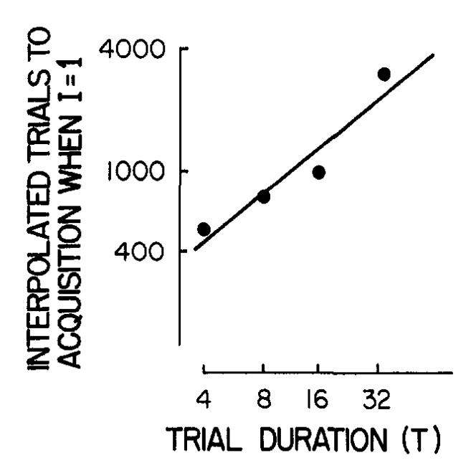
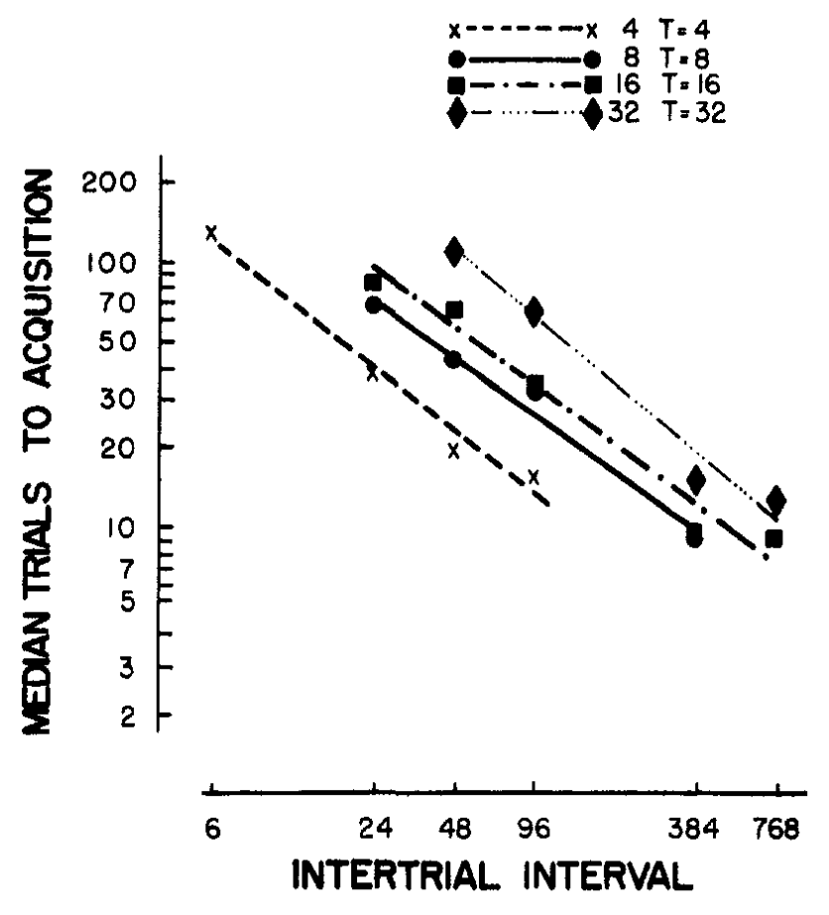
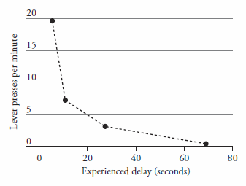
Timing
We have already seen how important time is for Pavlovian and operant conditioning

Slide 3

Cycle-to-trial ratio
The CS-US interval does not matter.

Slide 4
Cycle-to-trial ratio
The CS-US interval does not matter.
The ITI does not matter.

Slide 5

Cycle-to-trial ratio
The CS-US interval does not matter.
The ITI does not matter.
All that matters is the ratio between these two intervals.

Slide 6
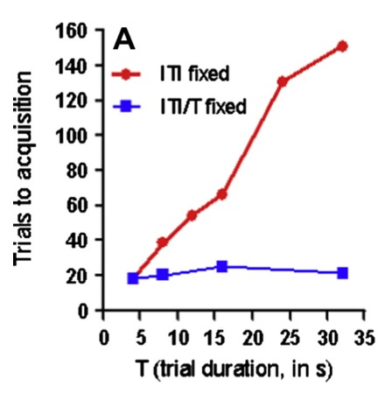
Cycle-to-trial ratio
T = CS-US interval
ITI/T is also called the cycle-to-trial ratio. Keeping the cycle-to-trial ratio constant results in a constant rate of learning.
Gallistel & Balsam (2014)

Slide 7
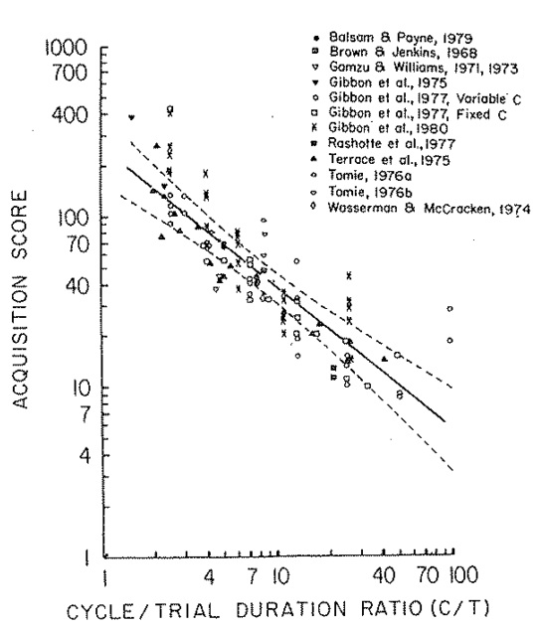
Cycle-to-trial ratio
What happens when we vary the cycle-to-trial ratio? Increasing the cycle-to-trial ratio results in faster learning.
Gibbon & Balsam (1981)

Slide 8
Cycle-to-trial ratio
Why does the cycle-t0-trial ratio influence the rate of learning?
Short answer: A large cycle-to-trial ratio makes the US’ dependency on the CS more noticeable.
Long answer: Ward, R. D., Gallistel, C. R., & Balsam, P. D. (2013). It’s the information! Behavioural Processes, 95, 3–7.

Slide 9
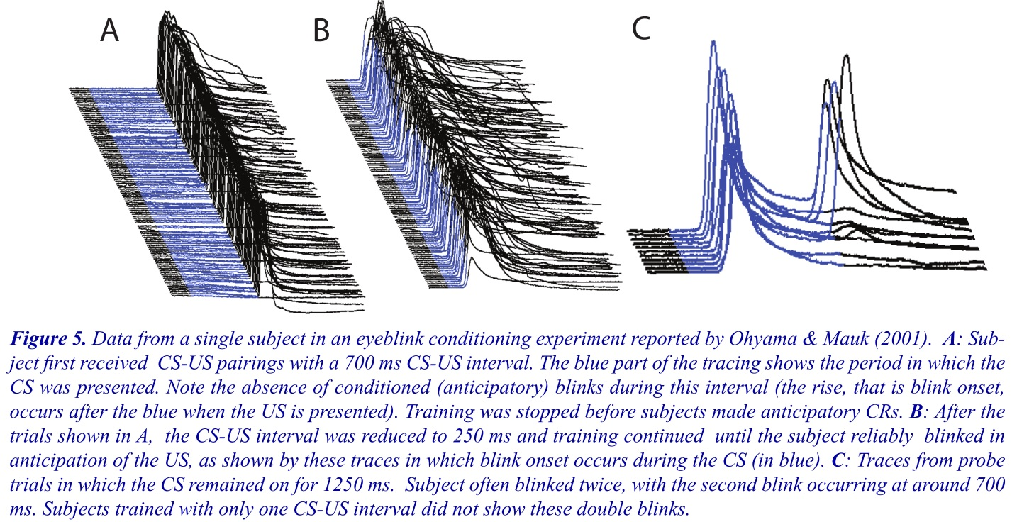
Timing
It is difficult to study timing. Behavior does not always reflect mental processes.

Slide 10
Duration estimation
Take out a pen/pencil and a piece of paper.
You will see three dots, with the center dot illuminated.

Slide 11
Duration estimation
After some interval of time, the center dot will turn off and the left and right dots will become illuminated. After everyone has chosen either the green or the red dot (it’s your choice), I will reveal the rewards.

Slide 12
Duration estimation
Let’s get started.

Slide 13
Duration estimation
Trial 1

Slide 14
Duration estimation
Trial 1

Slide 15
Duration estimation
Trial 1
0 points
1 point

Slide 16
Duration estimation
Trial 2

Slide 17
Duration estimation
Trial 2

Slide 18
Duration estimation
Trial 2
1 point
0 points

Slide 19
Duration estimation
Trial 3

Slide 20
Duration estimation
Trial 3

Slide 21
Duration estimation
Trial 3
1 point
0 points

Slide 22
Duration estimation
Trial 4

Slide 23
Duration estimation
Trial 4

Slide 24
Duration estimation
Trial 4
0 points
1 point

Slide 25
Duration estimation
Trial 5

Slide 26
Duration estimation
Trial 5

Slide 27
Duration estimation
Trial 5
1 point
0 points

Slide 28
Duration estimation
Trial 6

Slide 29
Duration estimation
Trial 6

Slide 30
Duration estimation
Trial 6
0 points
1 point

Slide 31
Duration estimation
Trial 7

Slide 32
Duration estimation
Trial 7

Slide 33
Duration estimation
Trial 7
1 point
0 point

Slide 34
Duration estimation
Trial 8

Slide 35
Duration estimation
Trial 8

Slide 36
Duration estimation
Trial 8
0 points
1 point

Slide 37
Duration estimation
Trial 9

Slide 38
Duration estimation
Trial 9

Slide 39
Duration estimation
Trial 9
0 points
1 point

Slide 40
Duration estimation
Trial 10

Slide 41
Duration estimation
Trial 10

Slide 42
Duration estimation
Trial 10
1 point
0 points

Slide 43

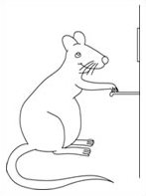

Duration production
Peak procedure
Lever is baited with reward 40 seconds after the light comes on.
80 seconds
Lever is baited with reward 20 seconds after the tone comes on.
80 seconds

Slide 44
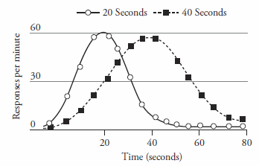
Duration production
Peak procedure

Slide 45
Duration production
Peak procedure
The peak response rate is different in the presence of each stimulus…

Slide 46
Duration production
Peak procedure
The peak response rate is different in the presence of each stimulus…
and so is the variance of the response rate distribution.

Slide 47
Duration production
Peak procedure
Scalar invariance:
The variability in response rates is proportional to the value of the interval being timed.
The peak response rate is different in the presence of each stimulus…
and so is the variance of the response rate distribution.

Slide 48
Scalar invariance
Scalar invariance:
The variability in response rates is proportional to the value of the interval being timed.
This is a consequence of the Weber-Fechner Law:
Animals perceive only the relative differences between intervals.
50 seconds
100 seconds
=
10 seconds
20 seconds

Slide 49
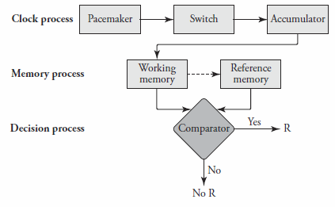
Scalar Expectancy Theory

