Slide 1
PSYC 3510 – Lecture 18

Slide 2
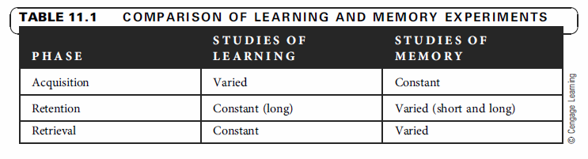
Memory

Slide 3
Spatial Memory
Morris water maze
https://www.youtube.com/watch?v=leHLL4vcbCc

Slide 4
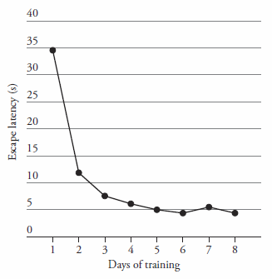
Spatial Memory
Morris water maze

Slide 5
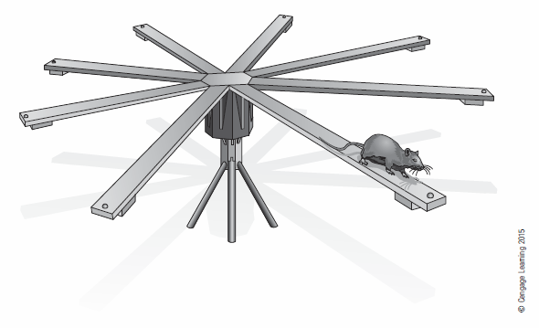
Spatial Memory
Radial arm maze
https://www.youtube.com/watch?v=8LAvXj65JNI

Slide 6
Spatial Memory
Radial arm maze
Ecological validity
Allows investigation of working memory (vary number of arms)
Allows investigation of long-term memory (vary retention interval)

Slide 7
Spatial Memory
Food caching
http://ny.pbslearningmedia.org/resource/nvbg-sci-corvidcaching/corvid-caching/

Slide 8
Spatial Memory
Food caching
Possible mechanisms:
Caches are found by consulting a spatial memory.
Caches are found by searching randomly.
Caches are found by smell or other markings.

Slide 9
Spatial Memory
Food caching
Possible mechanisms:
Caches are found by consulting a spatial memory.
Caches are found by searching randomly.
Caches are found by smell or other markings.
How can each of these hypotheses be ruled out?

Slide 10
Spatial Memory
Clark’s nutcrackers were allowed to store seeds in the opened cups of sand.

Slide 11
Spatial Memory
After a 10 day retention interval, all cups are opened. Where will the birds look for food?

Slide 12
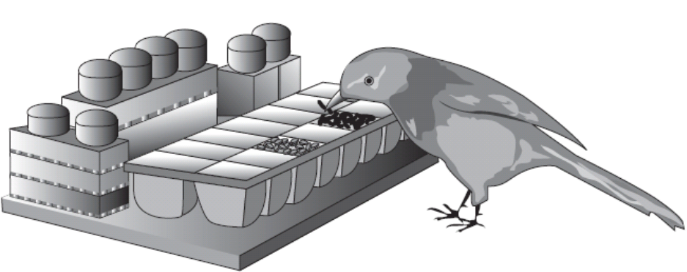
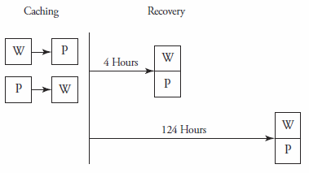
Spatial Memory
Food caching requires remembering what, when, and where.
W = worms
P = peanuts
Clayton & Dickinson (1999)

Slide 13
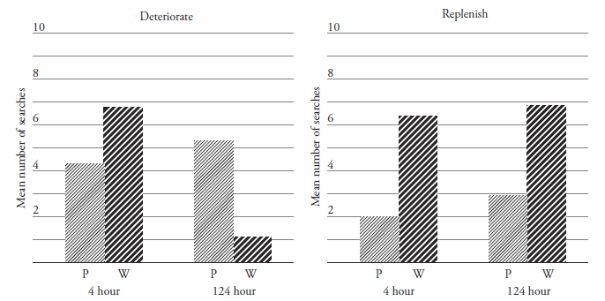
Spatial Memory
Food caching
Clayton & Dickinson (1999)

Slide 14
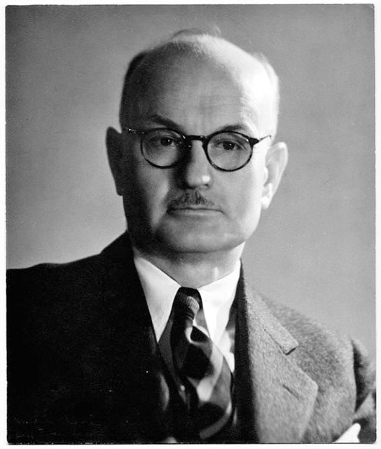
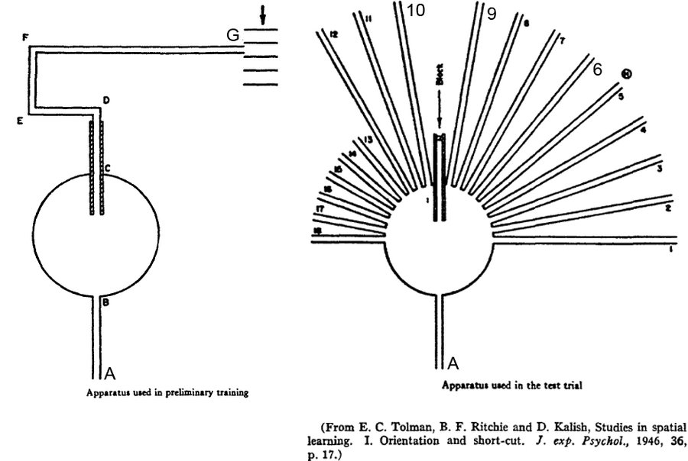
Navigational Codes
Cognitive maps
Edward Tolman

Slide 15
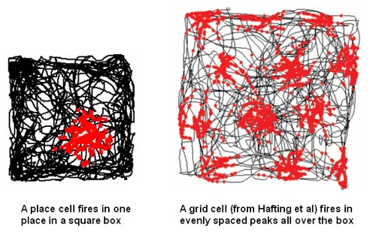

Navigational Codes
Cognitive maps
John O’Keefe
Place cell firing in hippocampus (red)
and rat location (black).
http://www.nobelprize.org/mediaplayer/index.php?id=2413

Slide 16
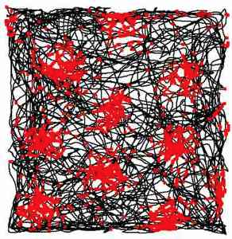
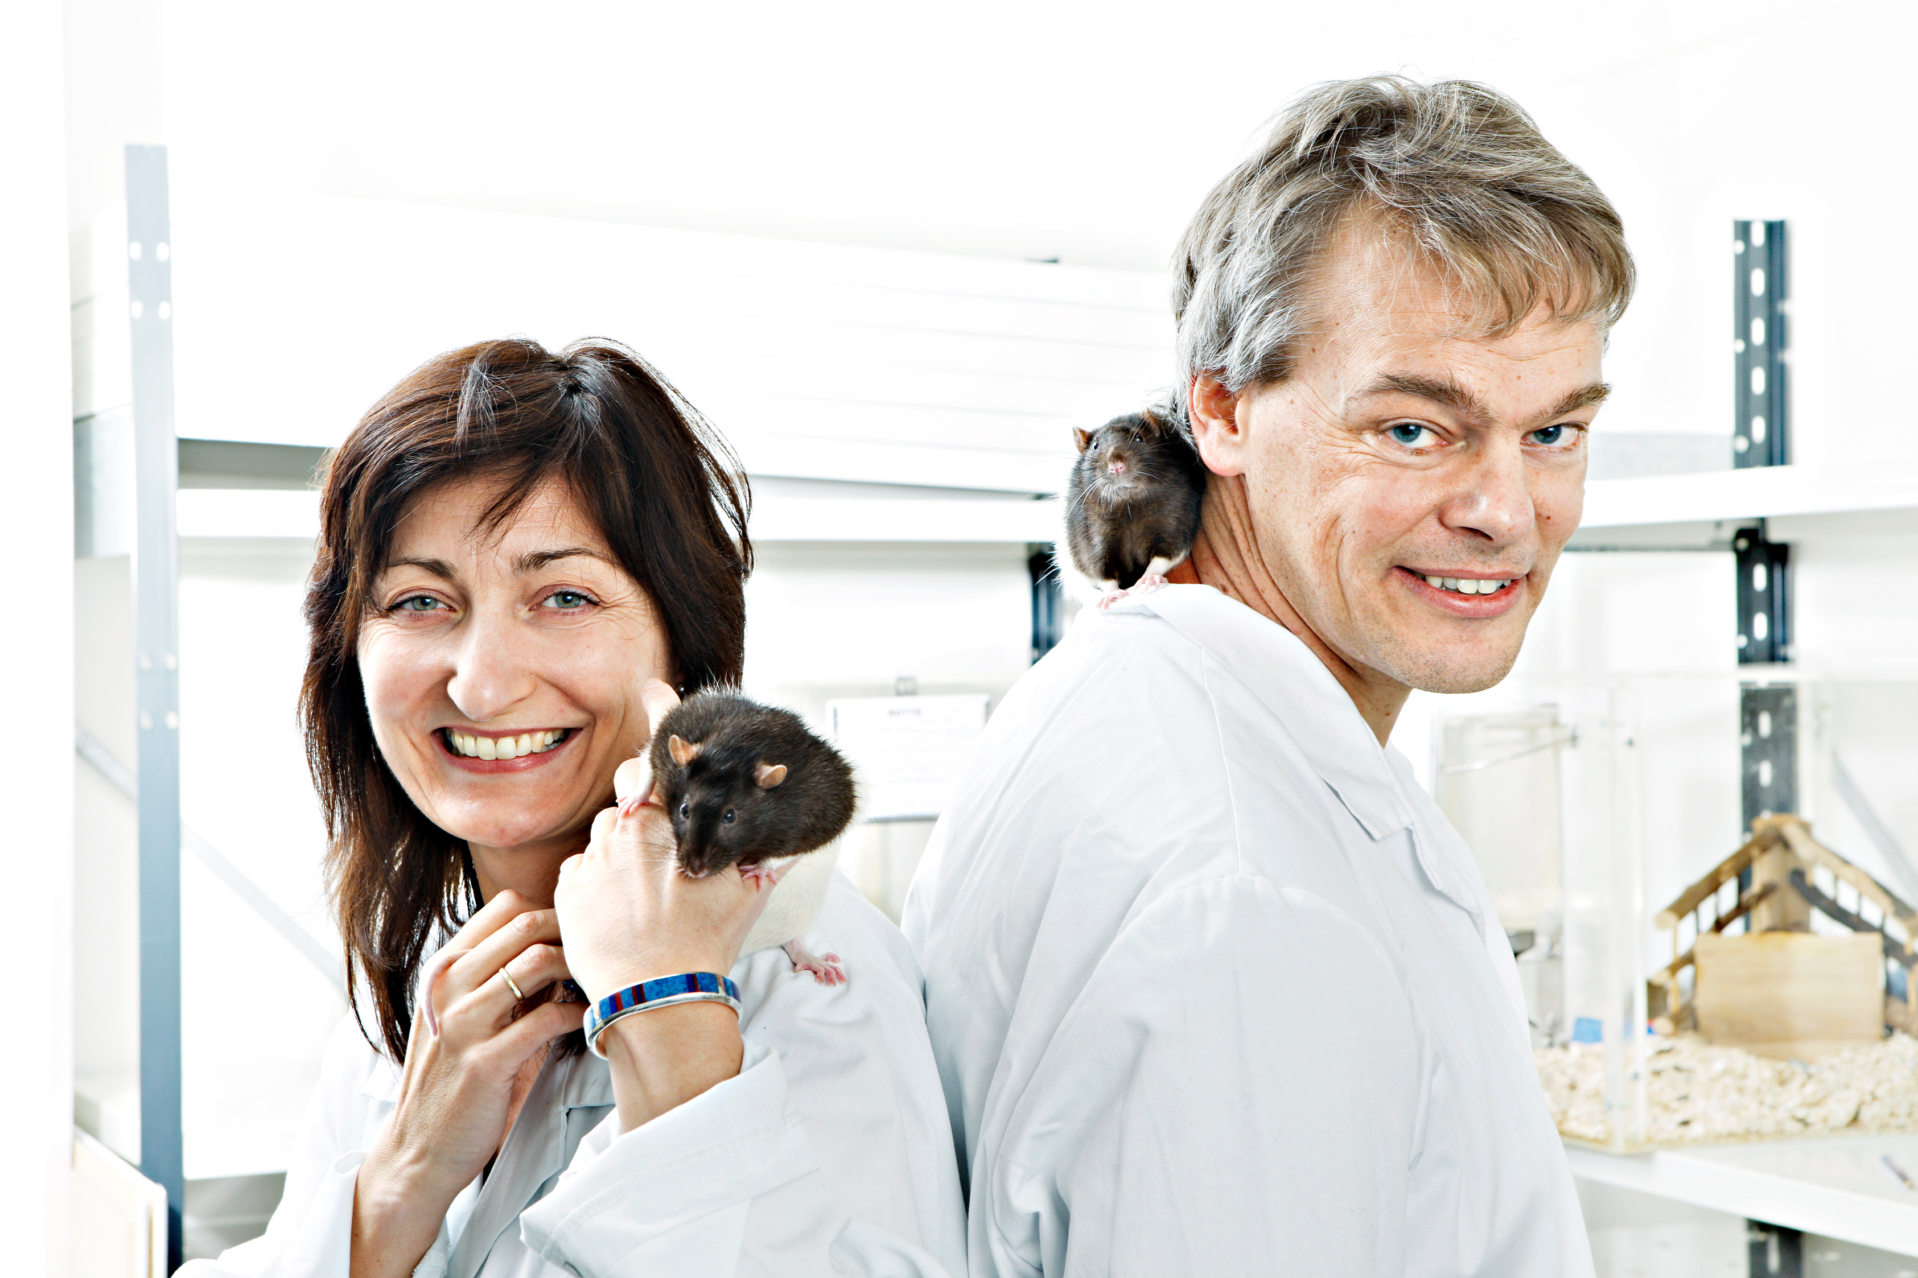
Navigational Codes
Cognitive maps
Edvard and May-Britt Moser
Grid cell firing in entorhinal cortex (red)
and rat location (black).
https://www.youtube.com/watch?v=i9GiLBXWAHI

Slide 17
Navigational Codes
Cognitive maps
What function is served by grid cells?

Slide 18
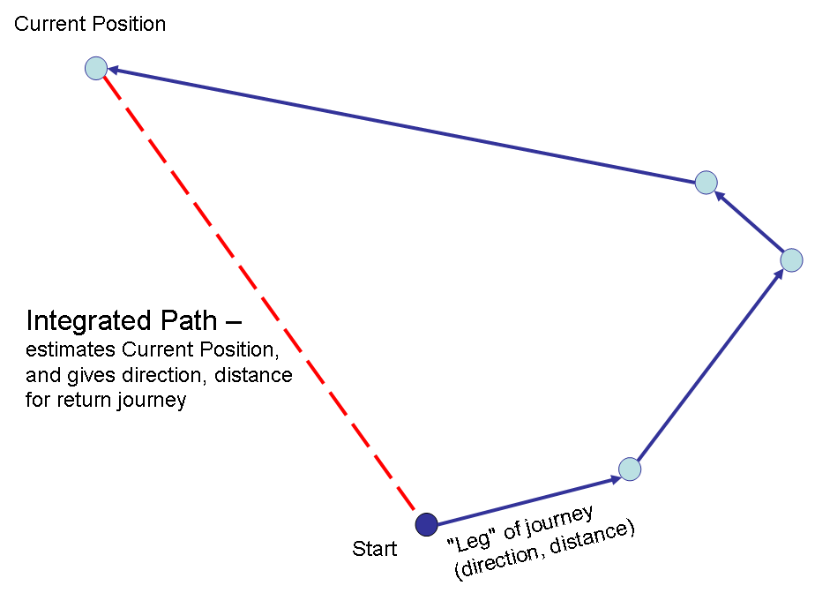
Navigational Codes
Cognitive maps
What function is served by grid cells?
Path integration:
Calculation of position from speed and direction,
independent of surrounding stimuli.

