Slide 1
PSYC 3510 – Lecture 13

Slide 2
Motivational mechanisms
How does the reinforcer influence operant responding?

Slide 3
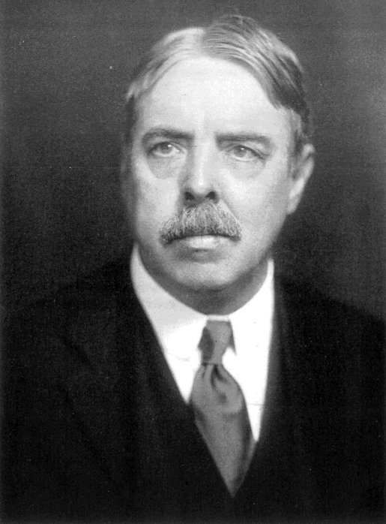
Motivational mechanisms
How does the reinforcer influence operant responding?
Remember Thorndike?
Law of Effect: If a response (R) in the presence of a stimulus (S) is followed by a satisfying event, then the association between S and R becomes strengthened.
stimulus → response

Slide 4
Motivational mechanisms
How does the reinforcer influence operant responding?
stimulus → response
According to Thorndike’s S-R theory of operant learning, the reinforcer serves to bring about
a state of satisfaction that serves as “glue” for the S-R bond.

Slide 5
Motivational mechanisms
How does the reinforcer influence operant responding?
stimulus → response
According to Thorndike’s S-R theory of operant learning, the reinforcer serves to bring about
a state of satisfaction that serves as “glue” for the S-R bond.
The stimulus (not the reinforcer!) controls the response. What does this imply about operant
behavior?

Slide 6
Motivational mechanisms
How does the reinforcer influence operant responding?
stimulus → response
According to Thorndike’s S-R theory of operant learning, the reinforcer serves to bring about
a state of satisfaction that serves as “glue” for the S-R bond.
The stimulus (not the reinforcer!) controls the response. What does this imply about operant
behavior?
1. If a response is not controlled by its reinforcer, then a stimulus that signals that reinforcer
should not motivate responding any more than an equally appetitive stimulus.
2. If a response is not controlled by its reinforcer, then altering the value of the reinforcer
offline (i.e. outside of the learning situation) should not have any effect on responding.

Slide 7
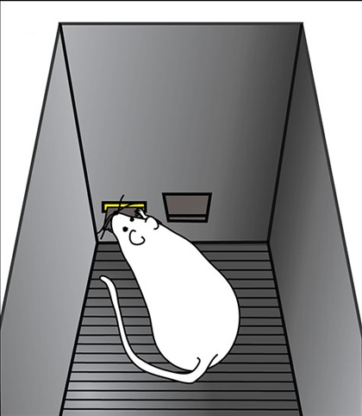




Pavlovian-instrumental transfer (PIT)
1. If a response is not controlled by its reinforcer, then a stimulus that signals that reinforcer
should not motivate responding any more than an equally appetitive stimulus.
Operant phase
Pavlovian phase

Slide 8
Pavlovian-instrumental transfer (PIT)
1. If a response is not controlled by its reinforcer, then a stimulus that signals that reinforcer
should not motivate responding any more than an equally appetitive stimulus.
Operant phase
Pavlovian phase
Choice test
Left lever vs. right lever
Left lever vs. right lever

Slide 9
Pavlovian-instrumental transfer (PIT)
1. If a response is not controlled by its reinforcer, then a stimulus that signals that reinforcer
should not motivate responding any more than an equally appetitive stimulus.
Operant phase
Pavlovian phase
Choice test
(Same refers to responding
on the left lever in the presence
of the light, and on the right
lever in the presence of the tone)
Left lever vs. right lever
Left lever vs. right lever

Slide 10
Pavlovian-instrumental transfer (PIT)
1. If a response is not controlled by its reinforcer, then a stimulus that signals that reinforcer
should not motivate responding any more than an equally appetitive stimulus.
Operant phase
Pavlovian phase
Choice test
(Same refers to responding
on the left lever in the presence
of the light, and on the right
lever in the presence of the tone)
Left lever vs. right lever
(Different refers to responding
on the right lever in the presence
of the light, and on the left
lever in the presence of the tone)
Left lever vs. right lever

Slide 11
Pavlovian-instrumental transfer (PIT)
Choice test
(Same refers to responding
on the left lever in the presence
of the light, and on the right
lever in the presence of the tone)
Left lever vs. right lever
(Different refers to responding
on the right lever in the presence
of the light, and on the left
lever in the presence of the tone)
Left lever vs. right lever

Slide 12
Pavlovian-instrumental transfer (PIT)
Choice test
(Same refers to responding
on the left lever in the presence
of the light, and on the right
lever in the presence of the tone)
Left lever vs. right lever
(Different refers to responding
on the right lever in the presence
of the light, and on the left
lever in the presence of the tone)
Left lever vs. right lever
*This shows that operant
responding is controlled by
an expectation of the reinforcer.

Slide 13
Goal sensitivity and habits
2. If a response is not controlled by its reinforcer, then altering the value of the reinforcer
offline (i.e. outside of the learning situation) should not have any effect on responding.
Phase 1
Two groups:
VI schedule
VR schedule

Slide 14
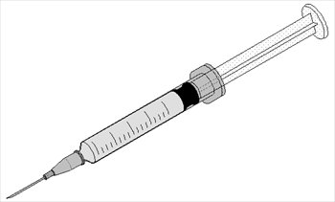
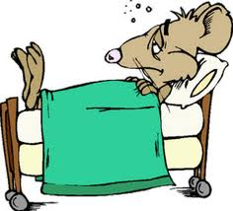
Goal sensitivity and habits
2. If a response is not controlled by its reinforcer, then altering the value of the reinforcer
offline (i.e. outside of the learning situation) should not have any effect on responding.
Phase 2
Two groups:
Devalued (lithium chloride injections)
Non-devalued (water injections)

Slide 15
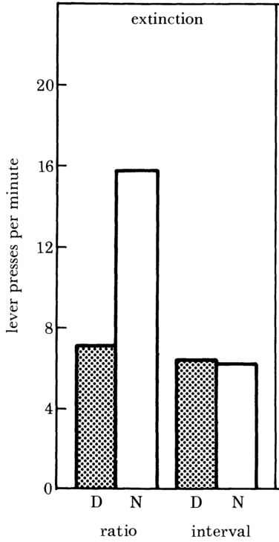
Goal sensitivity and habits
2. If a response is not controlled by its reinforcer, then altering the value of the reinforcer
offline (i.e. outside of the learning situation) should not have any effect on responding.
D = Devalued
N = Non-devalued
Dickinson, A., Nicholas, D. J., & Adams, C. D. (1983). The effect of the instrumental training contingency on susceptibility to reinforcer
devaluation. The Quarterly Journal of Experimental Psychology Section B, 35(1), 35–51.

Slide 16
Goal sensitivity and habits
2. If a response is not controlled by its reinforcer, then altering the value of the reinforcer
offline (i.e. outside of the learning situation) should not have any effect on responding.
D = Devalued
N = Non-devalued
Dickinson, A., Nicholas, D. J., & Adams, C. D. (1983). The effect of the instrumental training contingency on susceptibility to reinforcer
devaluation. The Quarterly Journal of Experimental Psychology Section B, 35(1), 35–51.

Slide 17
Goal sensitivity and habits
2. If a response is not controlled by its reinforcer, then altering the value of the reinforcer
offline (i.e. outside of the learning situation) should not have any effect on responding.
*This shows that operant
responding is controlled by
an expectation of the outcome
only for the group that received
training on a VR schedule
D = Devalued
N = Non-devalued
Dickinson, A., Nicholas, D. J., & Adams, C. D. (1983). The effect of the instrumental training contingency on susceptibility to reinforcer
devaluation. The Quarterly Journal of Experimental Psychology Section B, 35(1), 35–51.

Slide 18
Goal sensitivity and habits
2. If a response is not controlled by its reinforcer, then altering the value of the reinforcer
offline (i.e. outside of the learning situation) should not have any effect on responding.
Goal-directed
Habitual
D = Devalued
N = Non-devalued
Dickinson, A., Nicholas, D. J., & Adams, C. D. (1983). The effect of the instrumental training contingency on susceptibility to reinforcer
devaluation. The Quarterly Journal of Experimental Psychology Section B, 35(1), 35–51.

Slide 19
Goal sensitivity and habits
Habitual responding implies that the reinforcer does not control responding.
What causes behavior to become habitual?

Slide 20
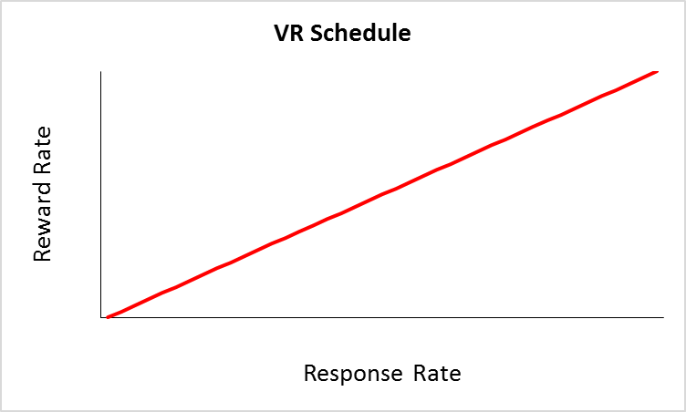
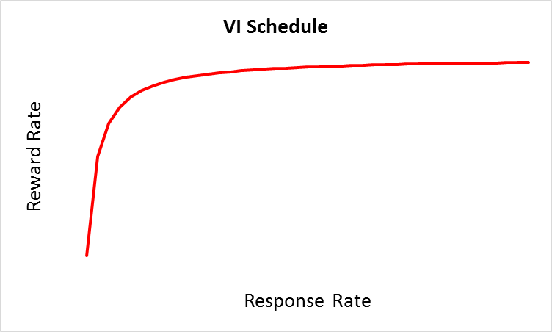
Goal sensitivity and habits
Recall the reward-response functions for VR and VI schedules
Under a VR schedule, an organism maintains a response-reward correlation. Under this schedule, reinforcement rate is directly tied to response rate. This promotes goal-directedness.
Under a VI schedule, an organism loses the response-reward correlation. Under this schedule, reinforcement rate is hardly affected by response rate. This promotes habits.

Slide 21
Goal sensitivity and habits
Recall the reward-response functions for VR and VI schedules
Under a VR schedule, an organism maintains a response-reward correlation. Under this schedule, reinforcement rate is directly tied to response rate. This promotes goal-directedness.
Under a VI schedule, an organism loses the response-reward correlation. Under this schedule, reinforcement rate is hardly affected by response rate. This promotes habits.
*Organisms become habitual when the consequences of a behavior are only loosely tied to variations in that behavior—when a sense of agency is lost.

Slide 22
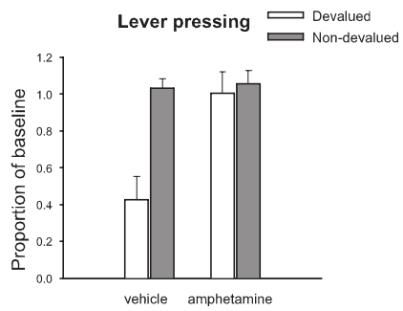
Goal sensitivity and habits
Habitual behavior has been tied to drug use.
Nelson, A., & Killcross, S. (2006). Amphetamine exposure enhances habit formation. The Journal of Neuroscience, 26(14), 3805–3812.

