Slide 1
PSYC 3510 – Lecture 12

Slide 2
Intertemporal choice
Delay discounting:
The idea that the value of a reinforcer declines with the amount of time by which it is delayed.
Would you rather have $10 now or $25 in 4 days?

Slide 3
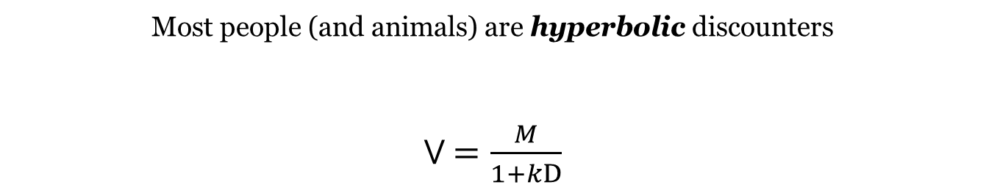
Intertemporal choice
Most people (and animals) are hyperbolic discounters
V $=\frac{M}{1+kD}$

Slide 4
Intertemporal choice
Most people (and animals) are hyperbolic discounters
V $=\frac{M}{1+kD}$
Reward magnitude
Delay
Subjective value of reward
Discounting rate parameter
(different for each person)

Slide 5
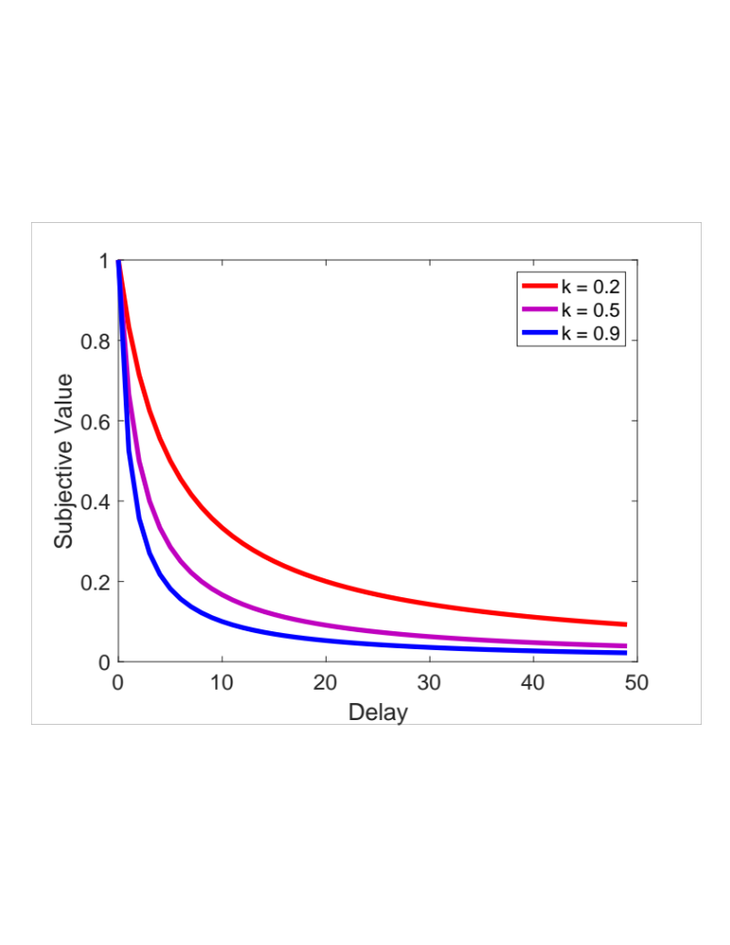
Intertemporal choice
Most people (and animals) are hyperbolic discounters
V $=\frac{M}{1+kD}$
Reward magnitude
Delay
Subjective value of reward
Discounting rate parameter
(different for each person)

Slide 6
Intertemporal choice
Most people (and animals) are hyperbolic discounters
V $=\frac{M}{1+kD}$
Reward magnitude
Delay
Subjective value of reward
Discounting rate parameter
(different for each person)
What is meant by ‘subjective value’?

Slide 7
Intertemporal choice
Activity
Take out a sheet of paper

Slide 8
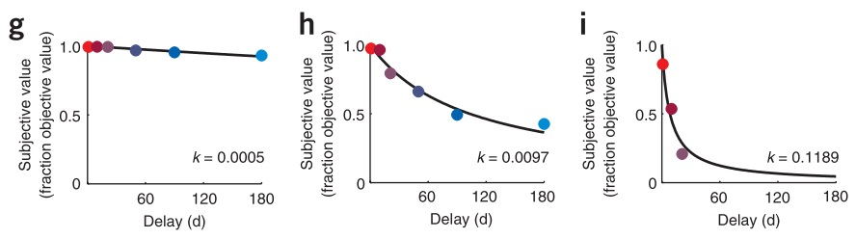
Intertemporal choice
How does one estimate the subjective value curve?
YH
JH
CH
Kable, J. W., & Glimcher, P. W. (2007). The neural correlates of subjective value during intertemporal choice. Nature Neuroscience, 10(12), 1625–33.

Slide 9
Intertemporal choice
How does one estimate the subjective value curve?
YH
JH
CH
Kable, J. W., & Glimcher, P. W. (2007). The neural correlates of subjective value during intertemporal choice. Nature Neuroscience, 10(12), 1625–33.

Slide 10
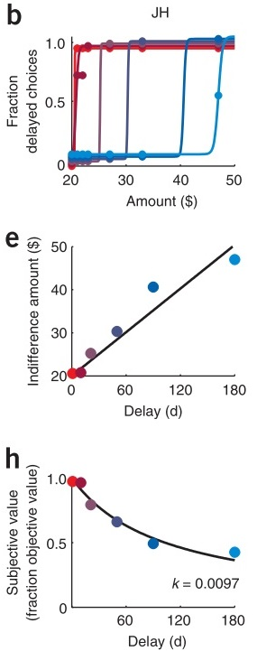

Intertemporal choice
Find indifference points.
When repeatedly offered a choice between $20 now of $40 in 90 days,
subject JH chooses the delayed option 50% of the time. This means
he/she is indifferent—they could go either way. More formally, for JH
$20 now is identical to $40 in 90 days.

Slide 11
Intertemporal choice
Find indifference points.
When repeatedly offered a choice between $20 now of $40 in 90 days,
subject JH chooses the delayed option 50% of the time. This means
he/she is indifferent—they could go either way. More formally, for JH
$20 now is identical to $40 in 90 days.

Slide 12
Intertemporal choice
Find indifference points.
When repeatedly offered a choice between $20 now of $40 in 90 days,
subject JH chooses the delayed option 50% of the time. This means
he/she is indifferent—they could go either way. More formally, for JH
$20 now is identical to $40 in 90 days.
We can thus say that JH’s subjective value of money drops by half (0.5) if it is
delayed by 90 days.

Slide 13
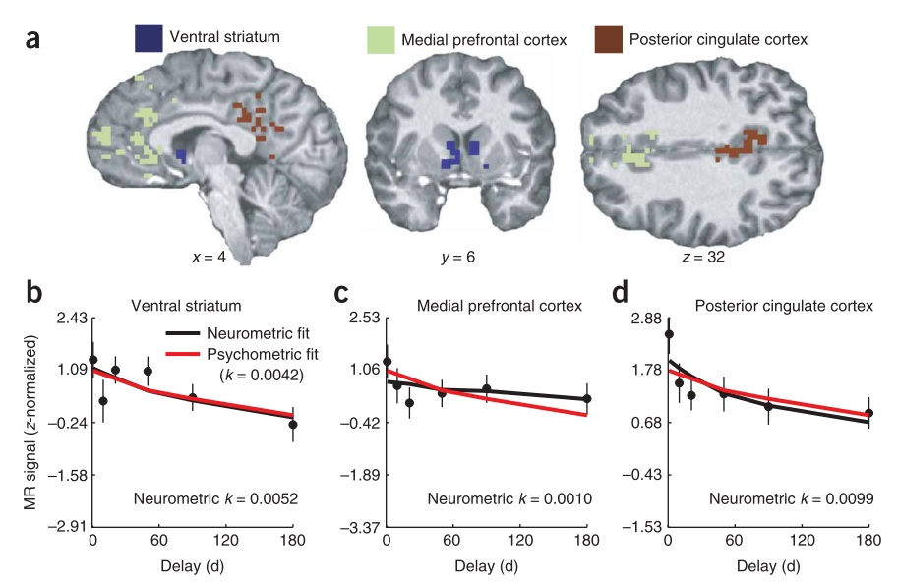
Intertemporal choice
Kable, J. W., & Glimcher, P. W. (2007). The neural correlates of subjective value during intertemporal choice. Nature Neuroscience, 10(12), 1625–33.

Slide 14

Intertemporal choice
Highly recommend!

Slide 15
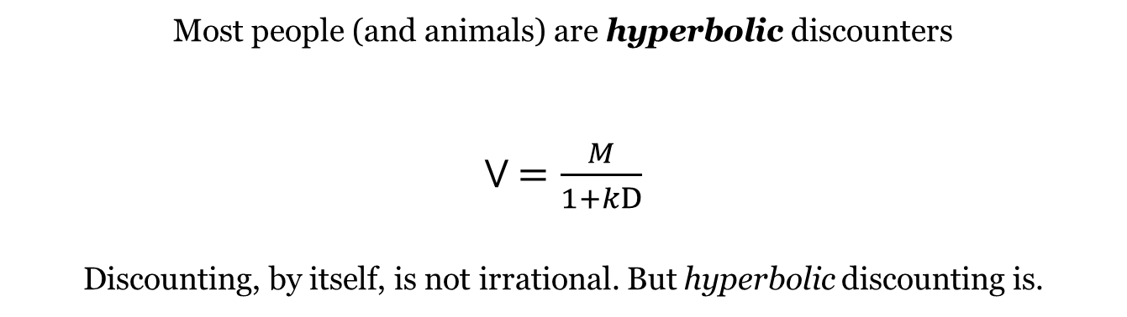
Intertemporal choice
Most people (and animals) are hyperbolic discounters
V $=\frac{M}{1+kD}$
Discounting, by itself, is not irrational. But hyperbolic discounting is.

Slide 16
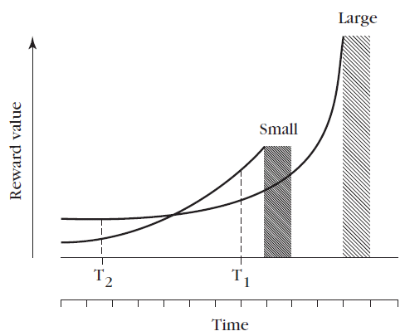
Intertemporal choice
Most people (and animals) are hyperbolic discounters
V $=\frac{M}{1+kD}$
Discounting, by itself, is not irrational. But hyperbolic discounting is.

Slide 17
Intertemporal choice
Most people (and animals) are hyperbolic discounters
V $=\frac{M}{1+kD}$
Discounting, by itself, is not irrational. But hyperbolic discounting is.
Preferences are not consistent over time!

Slide 18
Behavioral economics
Parallels between economics and operant behavior
Schedule of reinforcement = price
Response = spending
Reinforcement = commodity
*The goal of studying operant learning is to identify how responding (spending) is influenced by a schedule’s contingencies (prices).

Slide 19
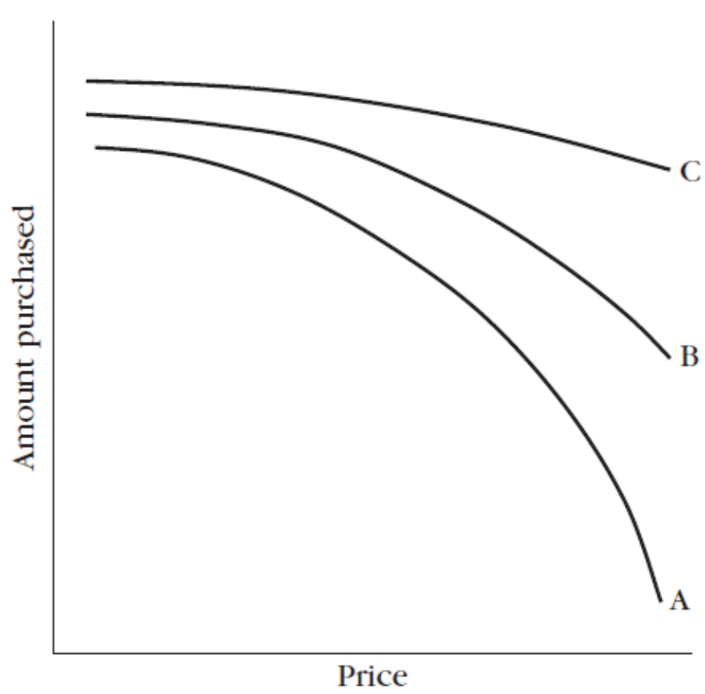
Behavioral economics
Demand Curve
Elasticity of demand:
The degree to which price
influences purchasing.

Slide 20
Behavioral economics
Demand Curve
Highly inelastic
(e.g. cigarettes)
Elasticity of demand:
The degree to which price
influences purchasing.
Highly elastic
(e.g. candy)

Slide 21
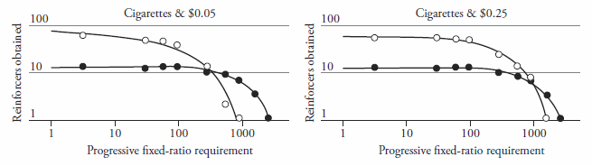
Behavioral economics
Demand Curve
FIGURE 7.10
Demand curves for cigarettes (solid circles) and money (open circles) with progressively larger fixed-ratio requirements. The number of reinforcers obtained, and the fixed-ratio requirements are both presented on logarithmic scales. (Based on Johnson & Bickel, 2006.)

Slide 22
Behavioral economics
Factors that affect elasticity of demand
Availability of substitutes
Price range
Income level

