Slide 1
PSYC 3510 – Lecture 11

Slide 2
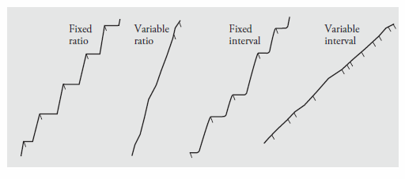
Simple schedules
- For fixed schedules, responding stops and resumes periodically.
- For variable schedules, responding is maintained at a steady rate.
- Ratio schedules tend to produce higher rates of responding compared to interval
schedules, even after controlling for the frequency and distribution of reinforcers.

Slide 3
Concurrent schedules
Concurrent schedules of reinforcement:
Two or more schedules that are simultaneously in effect.

Slide 4
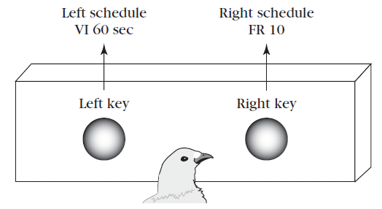
Concurrent schedules
Concurrent schedules of reinforcement:
Two or more schedules that are simultaneously in effect.
Left schedule
VI-60 seconds
Right schedule
VI-20 seconds

Slide 5
Concurrent schedules
How will animals distribute their choices?
Left schedule
VI-60 seconds
Right schedule
VI-20 seconds

Slide 6
Matching Law
Matching Law:
Animals will match their relative rates of responding to the relative rates of reinforcement.

Slide 7

Matching Law
Matching Law:
Animals will match their relative rates of responding to the relative rates of reinforcement.
B_{n} = total responses allocated to option n
R_{n} = total reinforcement collected from option n

Slide 8
Matching Law
B_{n} = total responses allocated to option n
R_{n} = total reinforcement collected from option n
How often should the pigeon peck on the right key?
Left schedule
VI-60 seconds
Right schedule
VI-20 seconds

Slide 9
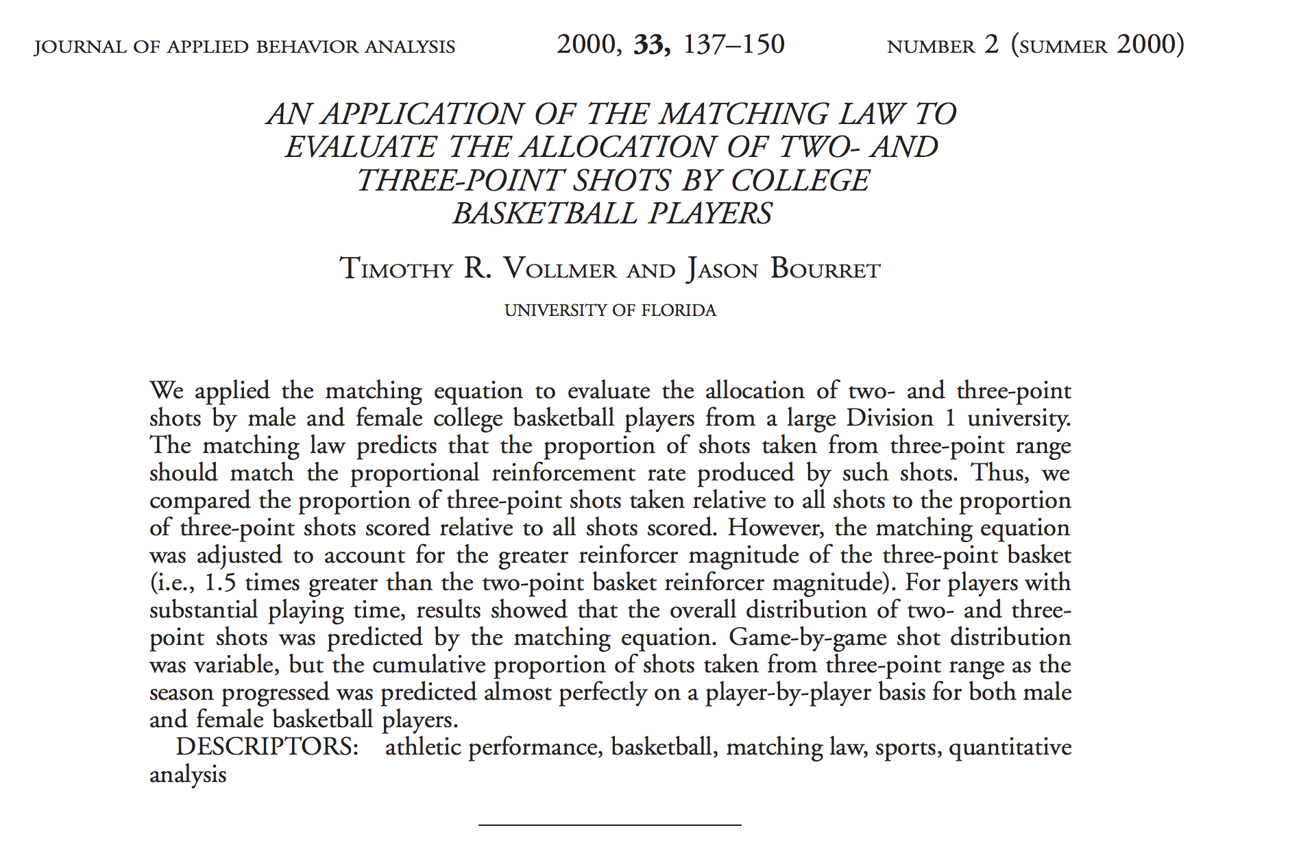
Matching Law

Slide 10
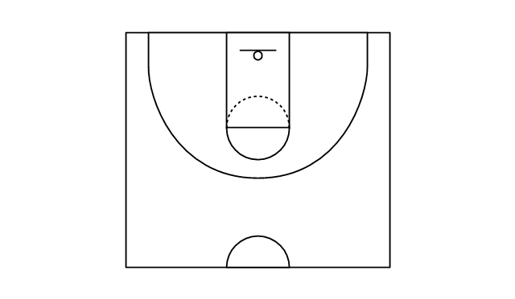
Matching Law
B_{n} = total responses allocated to option n
R_{n} = total reinforcement collected from option n
2 points
3 points

Slide 11
Matching Law
B_{n} = total responses allocated to option n
R_{n} = total reinforcement collected from option n
B₁ = Total number of 3-point shots
B₂ = Total number of 2-point shots
R₁ = Total points received from 3-point shots
R₂ = Total points received from 2-point shots
In the 2015-2016 regular season, Steph Curry scored 402 3-pointers and 805 2-pointers.
He also attempted 2484 total shots (3-pointers and 2-pointers combined). If Steph Curry’s
behavior obeyed the matching law, how many 3- and 2-pointers should we expect him to have
attempted?

Slide 12

Matching Law
B_{n} = total responses allocated to option n
R_{n} = total reinforcement collected from option n
B₁ = Total number of 3-point shots
B₂ = Total number of 2-point shots
R₁ = Total points received from 3-point shots
R₂ = Total points received from 2-point shots
In the 2015-2016 regular season, Steph Curry scored 402 3-pointers and 805 2-pointers.
He also attempted 2484 total shots (3-pointers and 2-pointers combined). If Steph Curry’s
behavior obeyed the matching law, how many 3- and 2-pointers should we expect him to have
attempted?
$$\frac{x}{2484}= \frac{402(3)}{402\left(3\right)+805(2)}$$

Slide 13

Matching Law
B_{n} = total responses allocated to option n
R_{n} = total reinforcement collected from option n
B₁ = Total number of 3-point shots
B₂ = Total number of 2-point shots
R₁ = Total points received from 3-point shots
R₂ = Total points received from 2-point shots
In the 2015-2016 regular season, Steph Curry scored 402 3-pointers and 805 2-pointers.
He also attempted 2484 total shots (3-pointers and 2-pointers combined). If Steph Curry’s
behavior obeyed the matching law, how many 3- and 2-pointers should we expect him to have
attempted?
$$\frac{x}{2484}= \frac{402(3)}{402\left(3\right)+805(2)}$$
$$x=1069$$

Slide 14
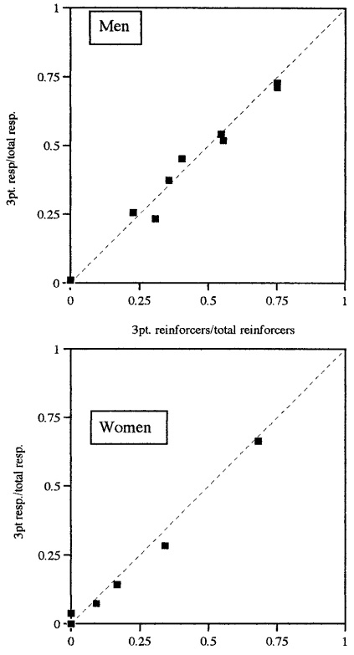
Matching Law

Slide 15

Matching Law
The matching law can also be stated as equality of the returns from two choices.
$$\frac{R_{1}}{B_{1}}= \frac{R_{2}}{B_{2}}$$

Slide 16

Matching Law
The matching law can also be stated as equality of the returns from two choices.
$$\frac{R_{1}}{B_{1}}= \frac{R_{2}}{B_{2}}$$
The amount of reward divided by the amount of responding is known as the return.

Slide 17

Matching Law
$$\frac{R_{1}}{B_{1}}= \frac{R_{2}}{B_{2}}$$
B_{n} = total responses allocated to option n
R_{n} = total reinforcement collected from option n
Suppose the pigeon makes a total of 100 key pecks.
Check to see if the equality holds true.
Left schedule
VI-60 seconds
Right schedule
VI-20 seconds

Slide 18
Matching Law
Why do animals match?
Is matching a rational strategy?

Slide 19
Matching Law
Why do animals match?
Is matching a rational strategy?
Not in a natural environment of diminishing returns!

Slide 20
Matching Law
Why do animals match?
Is matching a rational strategy?
Not in a natural environment of diminishing returns!

Slide 21
Matching Law
Why do animals match?
Is matching a rational strategy?
Not in a natural environment of diminishing returns!
Matching
(returns are equal)

Slide 22
Matching Law
Why do animals match?
Is matching a rational strategy?
Not in a natural environment of diminishing returns!
Total pleasure
from pizza
(multiply pizza
return
by x axis)

Slide 23
Matching Law
In an scenario where an option’s return diminishes the more often
it is chosen, matching is not the best strategy. Matching occurs when the returns
for each option (pleasure/frequency of choice) are set equal to each other.
However, economic theory dictates that the income from the preferred option
(total pleasure for pizza) should be maximized. *For a thorough explanation,
see lecture videos posted on Blackboard.
Total pleasure
from pizza
(multiply pizza
return
by x axis)

Slide 24
Concurrent schedules
Concurrent chain schedule:
A concurrent schedule that involves two stages or links.
P = 0.20
P = 0.80
P = 0.20
P = 0.80
$10
$0
$3
$3
Zentall, T. & Stagner, J. (2010). Maladaptive choice behaviour by pigeons: an animal analogue and possible mechanism for gambling.
Proceedings of the Royal Society, 278, 1203-1208.

Slide 25
Concurrent schedules
What is the optimal choice?
Expected value:$2
Expected value:$3
P = 0.20
P = 0.80
P = 0.20
P = 0.80
$10
$0
$3
$3
Zentall, T. & Stagner, J. (2010). Maladaptive choice behaviour by pigeons: an animal analogue and possible mechanism for gambling.
Proceedings of the Royal Society, 278, 1203-1208.

Slide 26
Concurrent schedules
What is the optimal choice?
Expected value:$2
Expected value:$3
P = 0.20
P = 0.80
P = 0.20
P = 0.80
$10
$0
$3
$3
Zentall, T. & Stagner, J. (2010). Maladaptive choice behaviour by pigeons: an animal analogue and possible mechanism for gambling.
Proceedings of the Royal Society, 278, 1203-1208.

