Slide 1
PSYC 3510 – Lecture 10

Slide 2
In-class writing
  There is someone in your life that you frequently lend money to. To get them to pay you back, you have two options:
  Promise to lend them more money in the future (positive reinforcement).
  Threaten to charge a late fee (negative reinforcement).
  Is one type of reinforcement more effective than the other? Why?

Slide 3
Common themes
  Promising future loans is more effective than threatening a late fee because it is better to be nice and not mean.

Slide 4
Common themes
  The promise of future loans will cause the person to not pay you back and keep asking for more money.

Slide 5
Common themes
  Threatening to charge a late fee is more effective because the person would then avoid asking you more mor money in the future.

Slide 6
Schedules of Reinforcement
Schedule of reinforcement:
A program or rule that determines the frequency and timing of reinforcement in relation to behavior.

Slide 7
Schedules of Reinforcement
Schedule of reinforcement:
A program or rule that determines the frequency and timing of reinforcement in relation to behavior.
What are the optimal schedules for maintaining desirable behaviors and avoiding unwanted ones?

Slide 8
Simple schedules
Ratio schedule:
Reinforcement depends only on the number of responses that occur.
Two types: Fixed-ratio and Variable-ratio

Slide 9
Simple schedules
Fixed-ratio schedule:
One reinforcer for every n responses.

Slide 10
Simple schedules
Fixed-ratio schedule:
One reinforcer for every n responses (determined).
- e.g. 1 pellet is earned for every 5 lever presses (FR-5).
*
*

Slide 11
Simple schedules
Fixed-ratio schedule:
One reinforcer for every n responses (determined).
- e.g. 1 pellet is earned for every 5 lever presses (FR-5).
*
*
Raster plot

Slide 12
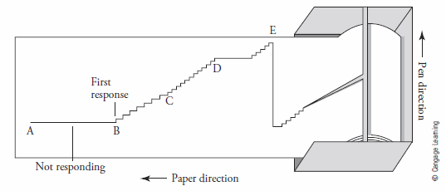
Simple schedules
Fixed-ratio schedule:
One reinforcer for every n responses (determined).
- e.g. 1 pellet is earned for every 5 lever presses (FR-5).
*
*
Raster plot
Cummulative record

Slide 13
Simple schedules
Fixed-ratio schedule:
One reinforcer for every n responses (determined).
- e.g. 1 pellet is earned for every 5 lever presses (FR-5).
*
*
Raster plot
Average rate
of responding
Cummulative record

Slide 14
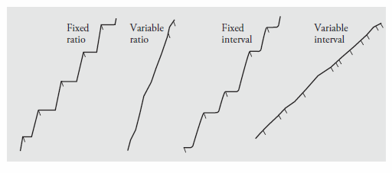
Simple schedules
Fixed-ratio schedule:
One reinforcer for every n responses (determined).

Slide 15
Simple schedules
Fixed-ratio schedule:
One reinforcer for every n responses (determined).
Reinforcement delivery

Slide 16
Simple schedules
Fixed-ratio schedule:
One reinforcer for every n responses (determined).
Post-reinforcement pause.
(Increases with ratio requirement)

Slide 17
Simple schedules
Variable-ratio schedule:
One reinforcer for every n responses (on average).
- e.g. 1 pellet is earned for every 5 lever presses on average (VR-5).
*
*
*
*
2
7
8
3

Slide 18
Simple schedules
Variable-ratio schedule:
One reinforcer for every n responses (on average).
- e.g. 1 pellet is earned for every 5 lever presses on average (VR-5).
*
*
*
*
2
7
8
3
VR schedules do not produce many post-reinforcement pauses. Why?

Slide 19
Simple schedules
Variable-ratio schedule:
One reinforcer for every n responses (on average).
- e.g. 1 pellet is earned for every 5 lever presses on average (VR-5).
*
*
*
*
2
7
8
3
VR schedules do not produce many post-reinforcement pauses. Why?
The probability that each response will be reinforced is constant.

Slide 20
Simple schedules
Variable-ratio schedule:
One reinforcer for every n responses (on average).
- e.g. 1 pellet is earned for every 5 lever presses on average (VR-5).
*
*
*
*
2
7
8
3
VR schedules do not produce many post-reinforcement pauses. Why?
The probability that each response will be reinforced is constant.
What does this remind you of?

Slide 21
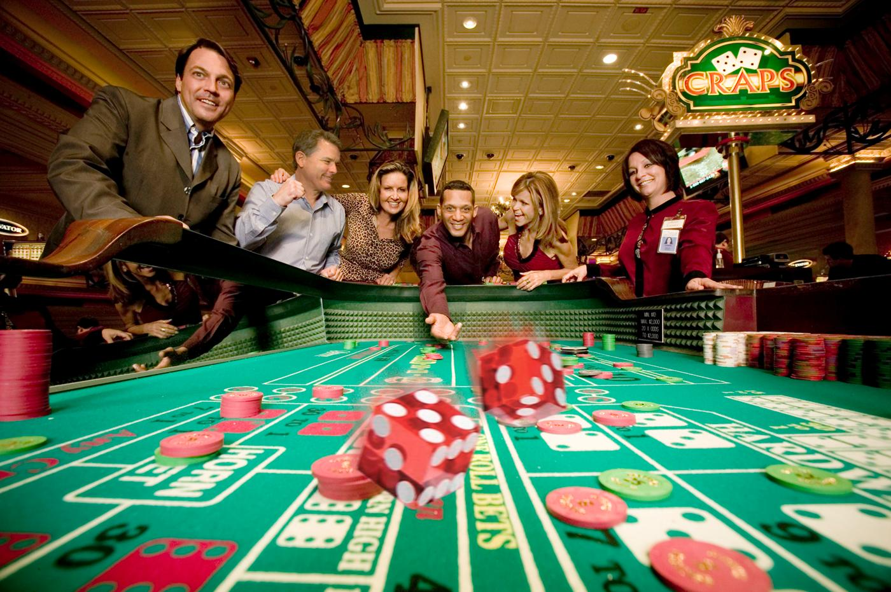


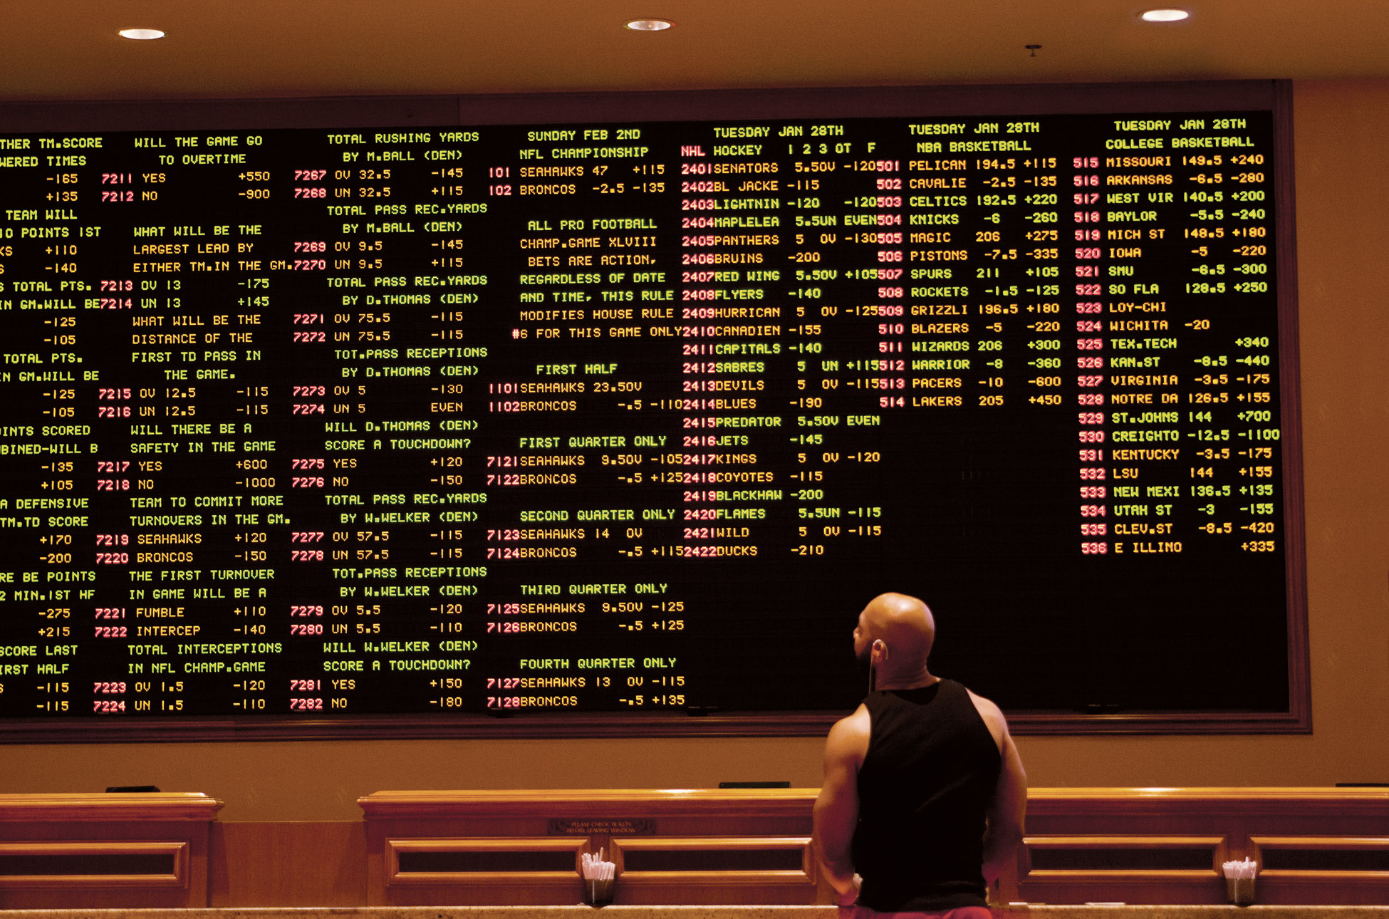
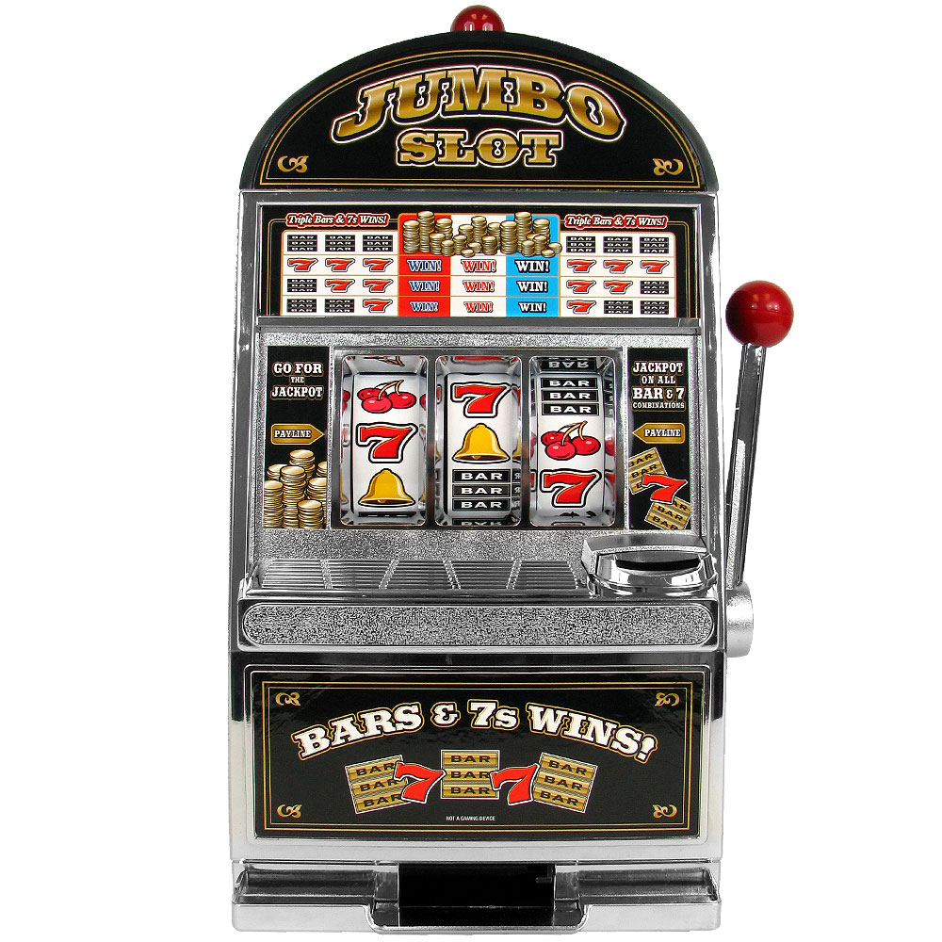

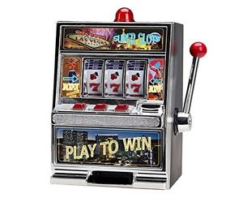
Simple schedules
Variable-ratio schedule:

Slide 22
Simple schedules
Interval schedule:
Reinforcement depends only on the time at which a response is made.
Two types: Fixed-interval and Variable-interval

Slide 23
Simple schedules
Fixed-interval schedule:
One reinforcer is available every n seconds (determined).
- e.g. A lever is baited every 5 seconds (FI-5).

Slide 24
Simple schedules
Fixed-interval schedule:
One reinforcer is available every n seconds (determined).
- e.g. A lever is baited every 5 seconds (FI-5).
*
*
*
*
*
1 2 3 4 5 6 7 8 9 10 11 12 13 14 15 16 17 18 19 20 21 22 23 24 25

Slide 25
Simple schedules
Fixed-interval schedule:
One reinforcer is available every n seconds (determined).
- e.g. A lever is baited every 5 seconds (FI-5).
*
*
*
*
*
1 2 3 4 5 6 7 8 9 10 11 12 13 14 15 16 17 18 19 20 21 22 23 24 25
Fixed-interval scallop

Slide 26
Simple schedules
Variable-interval schedule:
One reinforcer is available every n seconds (on average).
- e.g. A lever is baited, on average, every 5 seconds (VI-5).

Slide 27
Simple schedules
Variable-interval schedule:
One reinforcer is available every n seconds (on average).
- e.g. A lever is baited, on average, every 5 seconds (VI-5).
*
*
*
*
1 2 3 4 5 6 7 8 9 10 11 12 13 14 15 16 17 18 19 20

Slide 28
Summary
- For fixed schedules, responding stops and resumes periodically.
- For variable schedules, responding is maintained at a steady rate.
- Ratio schedules tend to produce higher rates of responding compared to interval
schedules, even after controlling for the frequency and distribution of reinforcers.

Slide 29
Summary
- For fixed schedules, responding stops and resumes periodically.
- For variable schedules, responding is maintained at a steady rate.
- Ratio schedules tend to produce higher rates of responding compared to interval
schedules, even after controlling for the frequency and distribution of reinforcers.
Why?

Slide 30
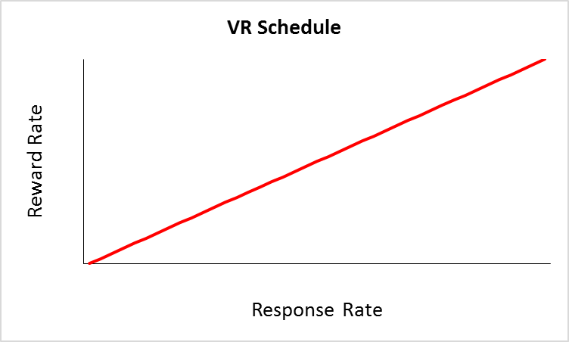
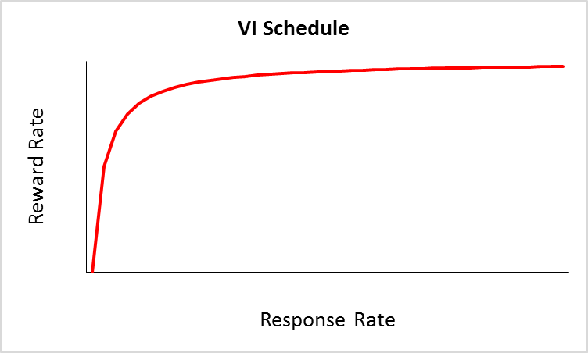
Summary

