Slide 1
PSYC 3510 – Lecture 9

Slide 2
Operant conditioning
Three components of operant conditioning:
- Response
- Reinforcer
- Response-Reinforcer Relationship

Slide 3
Operant conditioning
Three components of operant conditioning:
- Response
- Reinforcer
- Response-Reinforcer Relationship

Slide 4
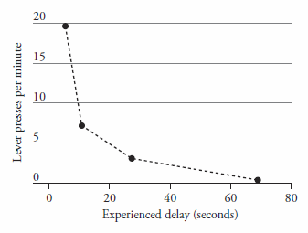
Contiguity
Dickinson, A., Watt, A., & Griffiths, W.J.H. (1992). Free-Operant Acquisition with Delayed Reinforcement. The Quarterly Journal of Experimental Psychology, 45B(3), 241-258.

Slide 5
Contiguity
Why does operant conditioning depend so heavily on contiguity?

Slide 6
Contiguity
Why does operant conditioning depend so heavily on contiguity?
Credit assignment problem

Slide 7

Contiguity
Why does operant conditioning depend so heavily on contiguity?
Credit assignment problem
“In playing a complex game such as chess or checkers, or in writing a computer program, one has a definite success criterion – the game is won or lost. But in the course of play, each ultimate success (or failure) is associated with a vast number of internal decisions. If the run is successful, how can we assign credit for the success among the multitude of decisions?”
– Minsky, 1963

Slide 8
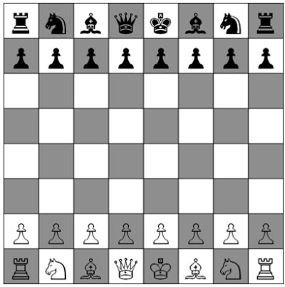

Contiguity

Slide 9
Contiguity
How does Gary Kasparov figure out which moves won him the chess game?

Slide 10
Contiguity
How does the mouse figure out which set of turns led it to the cheese?

Slide 11
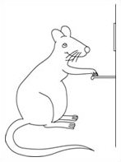

How is the credit assignment problem solved?
Solutions to the credit assignment problem:
- Eligibility trace: A decaying memory of having executed an action.
Time

Slide 12
How is the credit assignment problem solved?
Solutions to the credit assignment problem:
- Eligibility trace: A decaying memory of having executed an action.
Time

Slide 13

How is the credit assignment problem solved?
Solutions to the credit assignment problem:
- Conditioned reinforcement: Stimuli or actions that predict primary reinforcement and can reinforce preceding actions.

Slide 14

How is the credit assignment problem solved?
Solutions to the credit assignment problem:
- Conditioned reinforcement: Stimuli or actions that predict primary reinforcement and can reinforce preceding actions.
Will this rat acquire lever pressing? What is the proper control group?

Slide 15
How is the credit assignment problem solved?
Solutions to the credit assignment problem:
- Conditioned reinforcement: Stimuli or actions that predict primary reinforcement and can reinforce preceding actions.
How can conditioned reinforcement lead animals to learn long sequences
of actions in which primary reinforcement is delivered only at the end?

Slide 16
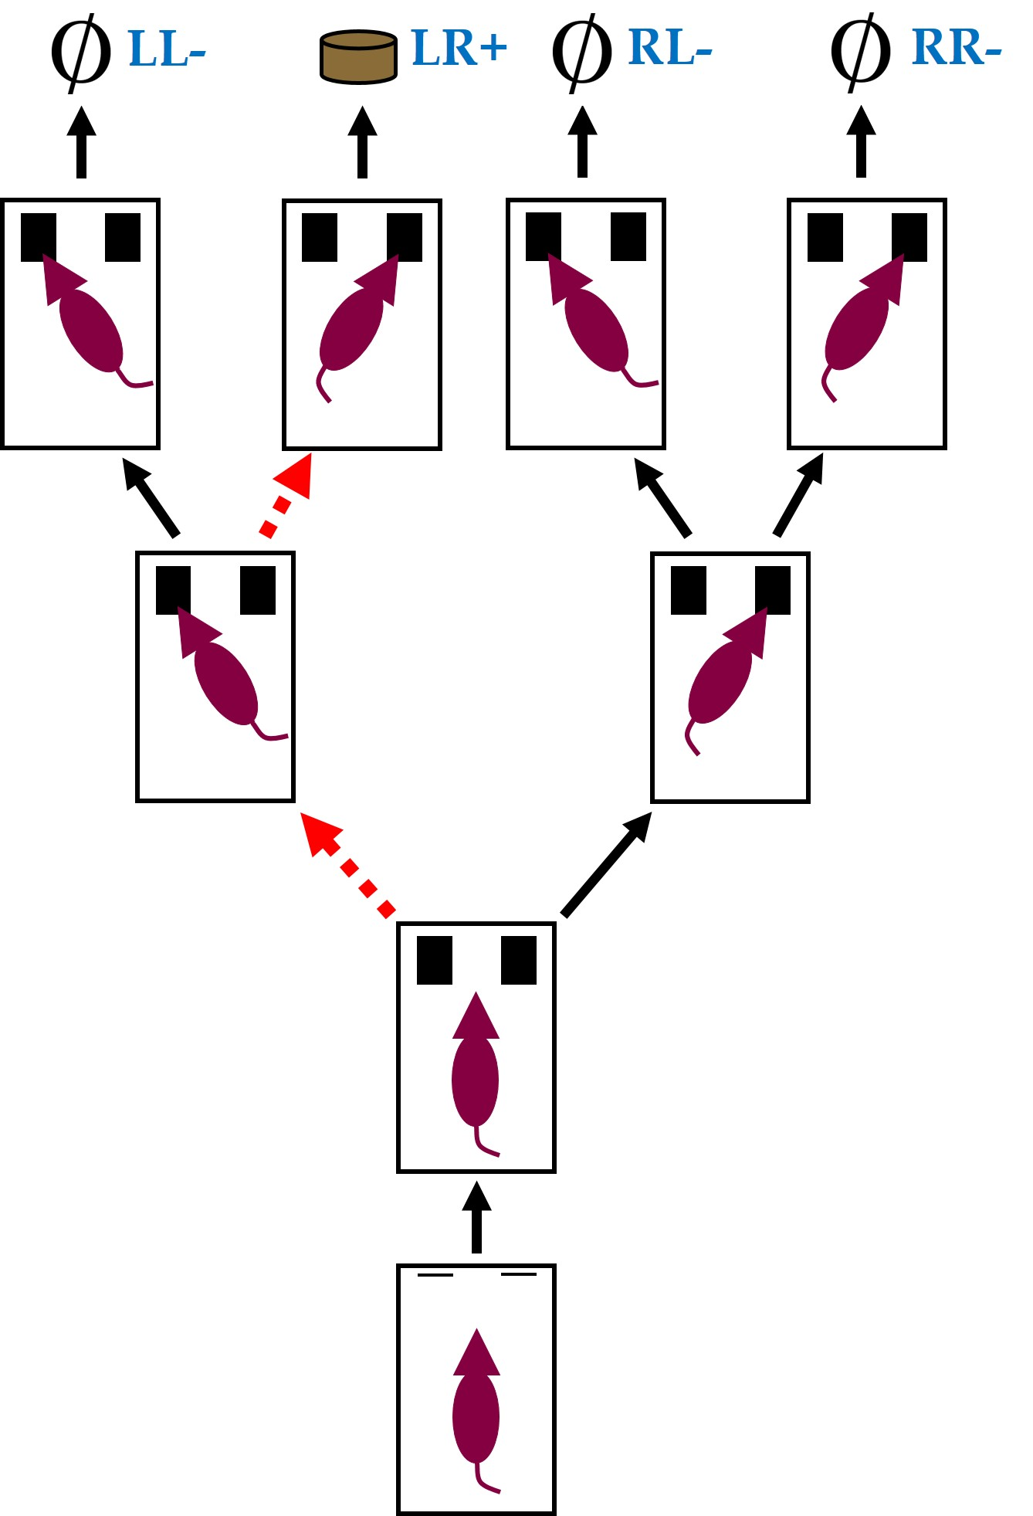
How is the credit assignment problem solved?
- The eligibility trace of an action becomes weaker with time.
- Conditioned reinforcement is always less effective than primary reinforcement.
Based on these facts, how would you expect the frequencies of each lever sequence (LL, LR, RL, RR) to change over time?

Slide 17
How is the credit assignment problem solved?

Slide 18


Contingency
Just like with Pavlovian conditioning, contingency is important too.
Left
Right
PLUS… noncontingent (i.e. free) pellets
Dickinson, A., Campos, J., Varga, Z.I., & Balleine, B. (1996). Bidirectional Instrumental Conditioning. The Quarterly Journal of Experimental Psychology, 49B(4), 289-306.

Slide 19
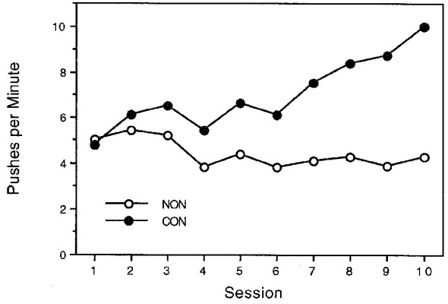
Contingency
Just like with Pavlovian conditioning, contingency is important too.
Dickinson, A., Campos, J., Varga, Z.I., & Balleine, B. (1996). Bidirectional Instrumental Conditioning. The Quarterly Journal of Experimental Psychology, 49B(4), 289-306.

Slide 20
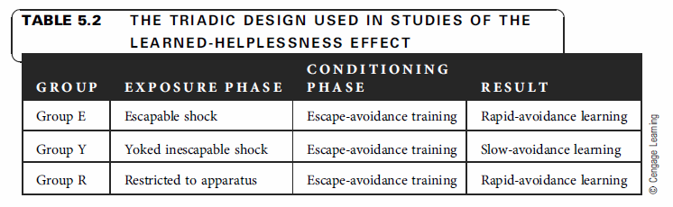
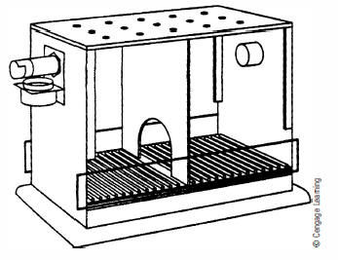
Contingency
Learned helplessness

Slide 21
Contingency
Learned helplessness hypothesis: Animals exposed to inescapable aversive stimuli learn that they cannot control those stimuli.

Slide 22
Contingency
Learned helplessness hypothesis: Animals exposed to inescapable aversive stimuli learn that they cannot control those stimuli.
Alternatives
Activity deficit hypothesis: Animals exposed to inescapable aversive stimuli are more likely to freeze and not move.

Slide 23
Contingency
Learned helplessness hypothesis: Animals exposed to inescapable aversive stimuli learn that they cannot control those stimuli.
Alternatives
Activity deficit hypothesis: Animals exposed to inescapable aversive stimuli are more likely to freeze and not move.
Stimulus relations hypothesis: Animals exposed to inescapable aversive stimuli are not able to predict the termination of shock based on the presence of salient stimuli.

